Slide 1


ZED Assessors Training Programme
5 Days Training Program
6th Mar to 10th Mar, 2017
Venue : CII- Gurgaon

Slide 2
Overview of of 5 days
Introduction of ZED Maturity Assessment Model, ZED Scheme, ZED Enablers / Outcome
1
2
ZED Parameters Details
ZED Assessment Details, Desktop Assessment
3
ZED Onsite Assessment, Case Study
4
Case Study, Mock Assessment, Course Recap, Examination, Feedback
5

Slide 3
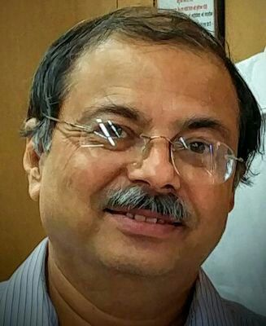



ZED Faculty
Mr. Anupam Kaul
Mr. P Girish
Mr. Virender Singh
Mr. Rahul Kaushik

Slide 4
ZED Observer Faculty
Mr. Amit Chauhan
Mr. Manoocha

Slide 5
ZED Assessors Training Program
5 Days Training Program
Day 1
Session 1 - Your Role & Introduction of ZED

Slide 6
Introductory Session
Name
Organization
Designation
Total work experience
work experience in quality related areas
Career highlights

Slide 7
Day 1 Session 1 - Your Role & Introduction of ZED

Slide 8
Day-1 Sessions
Process Design for Quality - 7 Sub Parameters
Session -1 Course Introduction Participant Introduction ZED Journey ZED Scheme Guidelines | Session -2 ZED Maturity Model Organizational & Operational Parameters Certification Programme - Assessment Criteria ZED Maturity Matrix : Explanation of Levels Vs Rating Sectors Covered Defence Model
Session -3 ZED Disciplines – Introduction to Operational Parameters Concept of Enablers Vs Results Production management (infrastructure) | Session -4 Production management (supply chain)- 8 sub parameters

Slide 9
Day-2 Sessions
Process Design for Quality - 7 Sub Parameters
Session -1 Quality Management - 8 sub parameters | Session -2 Environment Management - 9 sub parameters
Session -3 Human Resource Management - 2 Sub Parameters Safety Management -2 Sub Parameters Intellectual Property - 4 Sub Parameters | Session -4 Design Management - 2 Sub Parameters Energy Management - 3 Sub Parameters Overall Company Performance- 3 Sub Parameters

Slide 10
Day-3 Sessions
Process Design for Quality - 7 Sub Parameters
Session -1 ASSESSMENT Understanding Zed Scheme Guidelines (Certification Programme ) Online Registration Process – Demo Case Exercixse 1 : Visualization Of Maturity | Session -2 Desktop Assessment Case Exercise 2 - Desktop Assessment
Session -3 Assessor Skills Roles & Responsibilities Of Assessor / Team Leader, And Technical Experts Assessment Team Competence Assessments Tools & Techniques Special Requirements For Maturity Assessments | Session -4 Planning For On Site Assessment On Site Assessment Planning : Case Exercise 3

Slide 11
Day-4 Sessions
Process Design for Quality - 7 Sub Parameters
Session -1 Onsite Assessment Execution Case Exercise 4 : Evaluating Production Systems ( Infrastructure) & Safety Management | Session -2 Case Exercise 5 : Evaluating Production Management (Supply Chain)
Session -3 Case Exercise 6 : Evaluating Quality Management & Design | Session -4 Case Exercise 7 : Environment Management - & Energy Management

Slide 12
Day-5 Sessions
Process Design for Quality - 7 Sub Parameters
Session -1 Case Exercise 8 : Evaluating Human Resource Management Case Exercise 9 :Evaluating Overall Company Perrormance | Session -2 Mock Assessment - Role Play
Session -3 Course Recap Sharing Of Concerns | Session -4 Examination

Slide 13
Evaluation Criteria for 5 Days Assessors Training Programme

Slide 14
A. EVALUATION CRITERIA:
S. No. | Criteria | MARKS
1 | Continuous / Ongoing Evaluation | 10
2 | Case-Study Exercises / Role play | 30
3 | Written Examination | 60
TOTAL MARKS |  | 100
Minimum Passing Marks: 75 Marks for Assessor to become qualified ZED Assessors along with meeting prerequisite qualification / experience.

Slide 15
B. MANDATORY REQUIREMENT:
The participant must attend all 5 days of the training.
The participant will not be eligible to appear for the written exam even if one day of the training is not attended

Slide 16
C. DETAILS OF THE EVALUATION CRITERIA:
1. Continuous/Ongoing Evaluation: Maximum 10 marks as per the following:
1.1 Punctuality: Maximum 5 marks.
a) The participant reporting on/before time and leaving only after the day’s sessions are complete will be awarded 1 mark for each day.
b) No marks will be awarded if the participant arrives later than 30 minutes of the commencement of the day’s first session and/or leaves before completion of the day’s last session.
2 Classroom Participation: Maximum 5 Marks.
The participant will be assessed as per the following grading:

Slide 17
C. DETAILS OF THE EVALUATION CRITERIA: 1. Continuous/Ongoing Evaluation (cont......)
Level | Grading Criteria of participant
1 | Absent
2 | Present, not disruptive. Tries to respond when called on but does not offer much. Demonstrates very infrequent involvement in discussion.
3 | Demonstrates adequate preparation: knows basic case but does not show evidence of trying to interpret or analyze. Offers straightforward information without elaboration or very infrequently (perhaps once a session). Does not offer to contribute to discussion, but contributes to a moderate degree when called on. Demonstrates sporadic involvement.
4 | Demonstrates good preparation: knows case well, has thought through implications of them. Offers interpretations and analysis of case material (more than just facts). Contributes well to discussion in an ongoing way: responds to other students’ points, thinks through own points, questions others in a constructive way, offers and supports suggestions that may be counter to the majority opinion. Demonstrates consistent ongoing involvement.
5 | Demonstrates excellent preparation: has analyzed case exceptionally well, relating it to readings and other material (e.g., readings, course material, discussions, experiences, etc.). Offers analysis, synthesis, and evaluation of case material, e.g., puts together pieces of the discussion to develop new approaches that take the class further. Contributes in a very significant way to ongoing discussion: keeps analysis focused, responds very thoughtfully to other participants’ comments, contributes to the cooperative argument-building, suggests alternative ways of approaching material and helps class analyze which approaches are appropriate, etc. Demonstrates very active ongoing involvement.

Slide 18
2. Case Study Exercises / Role Play
Maximum 30 Marks as per the following:
All Exercise activities shall be performed in groups
Each group shall be expected to present its findings –lead by one person by rotation
Common marks shall be allotted to candidates in the group
The assessment will be done as follows:
S. No. | Criteria |  | Marks
 |  |  | Level 1 | Level 2 | Level 3
1 | Time Management |  | 2 | - | 6
2 | Quality of output |  | 2 | 4 | 6
3 | Presentation of findings |  | 2 | 4 | 6
4 | Communication Skills | Verbal | 2 | 4 | 6
 |  | Non Verbal | 2 | 4 | 6
Legend:
Level 1: Not adequate; Level 2: Adequate ; Level 3: Above Average

Slide 19
2. Mock Delivery of allocated Topic/Case-Study: cont.........
Indicator | Participant’s ability to
Time Management | Stay calm and keep things in perspective and within time Organize and plan the session effectively Prioritize and allocate appropriately
Query Handling | Listen to the entire question Pause and allow himself/herself time to value the question and listener. Credit The Person for asking the question. Respond to the Question honestly and the best of his/her ability. Bridge to the next question by asking the audience a question.
Speaking Beyond the Slide | Explain a point in his/her own language and not just read from the slide or a document Use his/her experience in explaining a relevant topic Relate with a relevant example and encourage audience participation Engage the audience and not make the delivery monotonous
Verbal Communication | Express himself/herself using audible & relevant language Articulate clearly, use words or actions so as not be misconstrued Use words as a tool of persuasion Create an opportunity for healthy debate, stimulate thought and creativity
Non Verbal Communication | Exhibit positive body language traits such as gestures, facial expressions, eye contact and posture. Illustrate a level of comfort with the audience Modulate the sound of voice, including pitch, tone and volume and not sound sarcastic and mocking

Slide 20
3. Written Examination:
Written Examination: Maximum 60 Marks as per the following:
Total 60 Questions of 1 mark each
All objective questions: Multiple Choice, True/False etc.
To attempt all Questions; No Choice
Time: 2 Hours
Questions Paper in 3 parts:
Part 1: Scheme Guidelines: 10 questions
Part 2: ZED Maturity Assessment Model: 30 Questions
Part 3: Assessment/Consulting processes & Skills: 20 Questions

Slide 21
Day 1 Session 1 - Introduction of ZED : ZED Journey

Slide 22
THE ZED JOURNEY
Release of Funds for Pilot Project by DIPP
ZED model conceptualized
Pilot Project report released
SFC Meeting conducted
First SSC meeting
Sep ‘14
Mar ‘15
Dec ‘15
Feb ‘16
22-Aug ‘16
Jan ‘15
May ‘15
Jan ‘16
11-Jul ‘16
16-Jan. ‘17
06-Feb,’17
First draft of the ZED Model prepared
Ministry of MSME initiated Scheme approval process
Pilot Project Completed
Scheme NOTIFIED
Training of Master Trainers
Training of Master Trainers

Slide 23
ZED Genesis
“Our manufacuring should have
ZERO DEFECT so that our products should not be rejected in the global market. We must also keep in mind that our manufacturing is done with
ZERO EFFECT so that t does not have any negative impact on our environment".
Hon'ble Prime Minister
August 15, 2014
With an aim to make India a global manufacturing hub, the Prime Minister gave an open invitation to manufacturers and investors across the world to establish manufacturing units in India.
Notes:
Addressing the nation on India's 68th Independence Day (15-August 2014), Hon'ble Prime Minister Shri Narendra Modi urged the industry, especially the Micro, Small and Medium Enterprises (MSMEs) of India, to manufacture goods in the country with "zero defects" and to ensure that the goods have "zero effect" on the environment.
“We should manufacture goods in such a way that they carry zero defect and that our exported goods are never returned to us. We should manufacture goods with zero effect that they should not have a negative impact on the environment".

Slide 24
Understanding Scheme Guidelines

Slide 25
The Scheme
Name
FINANCIAL SUPPORT TO MSMEs IN ZED CERTIFICATION SCHEME
The Scheme is an extensive drive of the Government of India to enhance global competitiveness of MSMEs by providing them financial support in assessment, rating and handholding of its manufacturing processes on Quality and Environment aspects
“The Government has decided to implement the ZED Certification Scheme for 22,222 MSMEs unit with a total budget of Rs. 491 Crores (including Government of India contribution of Rs. 365 Crores) during the 12th Five Year Plan”

Slide 26
Roadmap
PILOT PROJECT
(Completed in Jan, 2016)
Scale-up
National Rollout
Pilot Project to test ZED Model
Evolve an ecosystem around ZED
Test existing value proposition and reveal deficiencies
Financial Support through subsidy by MoMSME
Assess, rate and handhold 22,222 MSMEs units in the next 2-3 years
Finalize value proposition for the ZED Scheme
Build Capacities and capabilities to Scale-up the model
Target to cover 1.25 mn MSMEs in the next 5-7 years

Slide 27

Objectivities of ZED Scheme
Objectives
Develop an Ecosystem for Zero Defect Manufacturing in MSMEs.
Promote adaptation of Quality tools/systems and Energy Efficient manufacturing.
Enable MSMEs for manufacturing of quality products.
Encourage MSMEs to constantly upgrade their quality standards in products and processes.
Drive manufacturing with adoption of Zero Defect production processes and without
impacting the environment.
Support ‘Make in India’ campaign.
Develop professionals in the area of ZED manufacturing and certification.

Slide 28
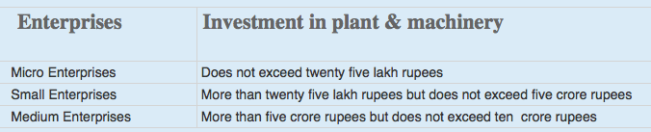
Applicability of the Scheme (1/2)
This is a voluntary scheme and is applicable to Micro, Small & medium Enterprises – Manufacturing Sector only. QCI has been nominated as the NMIU of the scheme.
Certification after assessment of a Manufacturing Unit’s systems & processes based on ZED Parameters.
An MSME WILL NOT BE ELIGIBLE to go for ZED Certification if the legal & regulatory compliances are not followed.
Definitions of Micro, Small & Medium Enterprises is in accordance with the provision of MSMED Act, 2006.
Manufacturing Enterprises are enterprises engaged in the manufacture or production of goods pertaining to any industry specified in the first schedule to the industries (Development and Regulation Act, 1951) or employing plant and machinery in the process of value addition to the final product having a distinct name or character or use. The Manufacturing Enterprise are defined in terms of investment in Plant & Machinery.

Slide 29
Applicability of the Scheme (2/2)
The generic model for Service Sector has been made and a pilot project to test and evolve the model is under consideration by DIPP, MoCI
Though Large industries are not covered in this scheme, the model is applicable across all sectors and size
An MSME must be registered under the UAM (Udyog Aadhaar Memorandum) to avail the benefits under the ZED scheme. Registrations under UAM are free. It may be noted that the Ministry has not appointed any representative for Udyog Aadhaar Registration.
UAM is a one-page simple registration form for online filing of UAM which replaces the filing of Entrepreneur’s Memorandum Part I & II. The filing of UAM can be done on http://udyogaadhaar.gov.in
Registration is online and user-friendly
UAM can be filed on self-declaration basis
No documentation required
No Fee for filing
File more than one Udyog Aadhaar with same Aadhaar Number.

Slide 30

Activities under ZED Scheme
Activities
Industry awareness programs, regional/state/national workshops, training of officials of DIs, TCs, DICs
Accreditation of Assessment & Consulting agencies, Training and certification of Assessors & Consultants
Online systems including e-platform for assessment and e-content for awareness & training
Assessment, Rating & Certification of MSMEs
Gap analysis & Handholding for improving rating of MSMEs
International Benchmarking

Slide 31




Methodology – key components
Awareness
and
Training
Awareness Programmes through Implementing Agencies like QCI, NPC, Chambers, MSME-DIs, MSME Technology Centers, Industry Associations, BEE, etc.
Training & Certification of eligible Master Trainers, Assessors and Consultants
To develop e-learning modules for capability building
Third party site-assessment
Assessments by Certified Assessors of accredited Credit Rating Agencies, and other accredited agencies etc.
Online auto-allocation of assessors and monitoring of Assessment process
Web App based Site-Assessments
Third party consultancy (gap analysis and handholding)
Consultancy by Certified Consultants of empanelled Consulting Agencies/Bodies, and Individual Consultants
Allocation of consultants and monitoring of Consulting process
App based reporting of Site-Visits
Certification
Final Rating and Certificates to be issued by QCI

Slide 32
Scheme governance
Routine functionalities
SSC chaired by Development Commissioner of MSME to guide, review, monitor and provide overall direction for implementation of the scheme
Quality Council of India (QCI) to function as the NMIU for the scheme
Overall guidance and direction
Screening and Steering Committee (SSC)
Chaired by DC-MSME
Facilitation, Implementation, Coordination and Monitoring
National Monitoring and Implementing Unit (NMIU)
QCI
Implementing Agencies
Rating & Other Agencies
Consultants & Consulting Bodies

Slide 33





ZED Rating & Certification
ZED is a Maturity Assessment Model
Assessment of a Unit on minimum 30 out of 50 parameters, including 20 mandatory parameters
Additional 25 parameters for MSMEs supplying to Defense Sector
Each parameter comprises of 5 Maturity levels
Level 1 (0 Marks)
Struggler
Level 2 (2 Marks)
Beginner
Level 3 (3 Marks)
Organized
Level 4 (4 Marks)
Achiever
Level 5 (5 Marks)
World Class

Slide 34
How does ZED rating system work?
5 levels of ZED rating system
An example
Company X is being rated on 30 parameters
Of these
30 para-meters
On 4 parameters the MSME is at Level 4
PLATINUM
On another 8 parameters it is at Level 3
>4.0
upto 5.0
DIAMOND
On remaining 18 parameters it is at Level 2
>3.5 upto 4.0
GOLD
Hence, the scores will be calcu-lated as
Parameters
Level
Marks
4
4
16
>3.0 & upto 3.5
8
3
24
SILVER
18
2
36
>2.5 & upto 3.0
Total
76
BRONZE
Company X Rating
(Total points/applicable parameters): 76 / 30 = 2.53
>2.2 & upto 2.5
COMPANY X is rated as: ZED SILVER
<2.2 No rating
NOTE: Score rounded off to 2 Decimal Places

Slide 35
7 Step Process flow for ZED rating
1
Registration
Online Registration by MSMEs
2
Online Self-assessment
MSMEs to self-assess based on ZED parameters
3
Desktop assessment
Assessment based on documents submitted by MSMEs
7 Steps towards ‘Excellence’
30 Days
4
Site assessment
On-site assessment of only MSMEs, selected in Desktop Assessment
8 Weeks
5
ZED rating & certification
Final ZED rating and certificate (valid for 4 years)
6
Gap analysis & handholding
Option to avail services of gap analysis & handholding
7
Re-assessment
Option to apply for re-assessment
Surveillance: On-site surveillance 2 times in a cycle (in 4 years)

Slide 36
FINANCIAL ASSISTANCE - Conditions
The full cost of the specific activity will be paid by the MSME before the start of the activity, and the subsidy is provided after completion of that activity and depending on certain conditions as explained below
Activity
Subsidy Details
1
Registration & Online Self-assessment
NO COST to MSME
2
Desktop assessment
Rs. 10,000/-
Subsidy provided to MSME irrespective of outcome
3
Site assessment
Rs. 80,000/-
Subsidy provided to MSME irrespective of outcome
4
Additional Defence Rating
Rs. 40,000/-
Subsidy provided to MSME irrespective of outcome
5
Gap analysis & handholding (optional)
Rs. 1,90,000/-
Subsidy provided to only those MSMEs which have achieved minimum Bronze rating after Site Assessment
6
Re-assessment/
Re-rating*
Rs. 40,000/-
Subsidy provided to only those MSMEs which graduate at least one level from their previous rating, after re-assessment. Eg: No Rating to Bronze, Bronze to Silver etc.
* MSMEs with No Rating after Site Assessment can also go for Re-assessment

Slide 37
Financial Support to MSMEs by Government Micro: 80%, Small: 60%, Medium: 50%
Total Cost
Cost to MSMEs according to its Type
1
Registration & Online Self-assessment
Micro Small Medium
No Cost No Cost No Cost
Registration,
Desktop
Assessment
&
Site-
Assessment
2
Desktop assessment
Rs. 10,000/-
Micro Small Medium
Rs. 2000/- Rs. 4000/- Rs. 5000/-
3
Site assessment
Rs. 80,000/-
Micro Small Medium
Rs. 16000/- Rs. 32000/- Rs. 40000/-
TOTAL ASSESSMENT COST to MSME
Rs. 18000/- Rs. 36000/- Rs. 45000/-
4
Additional Defence Rating
Rs. 40,000/-
Micro Small Medium
Rs. 8000/- Rs. 16000/- Rs. 20000/-
Defence
Assessment,
Consulting
& Re-
Assessment
5
Gap analysis & handholding (optional)
Rs. 1,90,000/-
Micro Small Medium
Rs. 38000/- Rs. 76000/- Rs. 95000/-
6
Re-assessment/Re-rating
Rs. 40,000/-
Micro Small Medium
Rs. 8000/- Rs. 16000/- Rs. 20000/-
Additional Subsidy of 5% for MSMEs owned by SC/ST/Women & MSMEs located in NER and J&K
Certification Costs are included in Site-assessment, Defence Rating and Re-assessment components
Surveillance Fee to be paid by MSMEs will be decided in due course

Slide 38

Benefits of ZED Scheme for MSMEs
Credible recognition for international investors seeking investment in India
Part of supply chain of national & international OEMs
Streamlined operations and lower costs
Superior quality, reduced rejection and higher revenues
Increased environmental consciousness and social benefits
“ZED Mark” to enable an MSME to be seen as a company with a difference
Other benefits expected to be announced by the Government in the near future

Slide 39
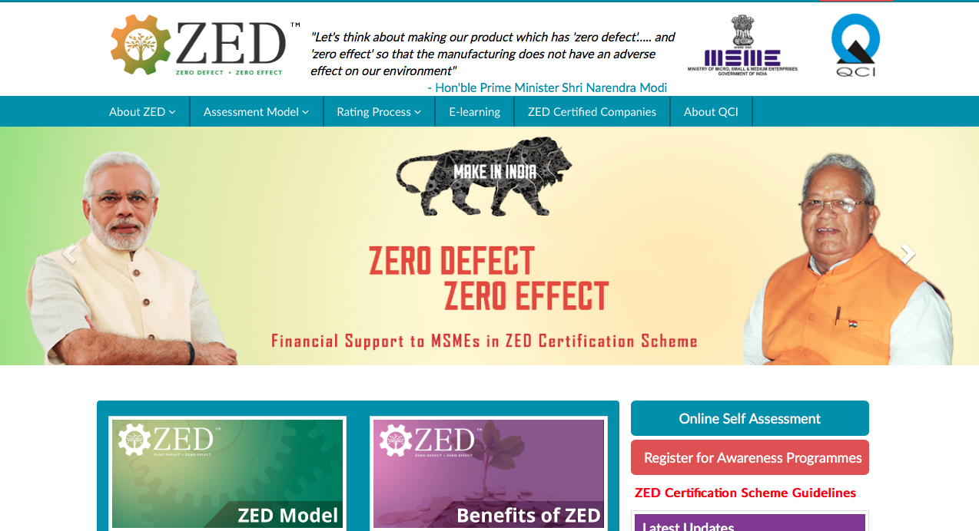
www.zed.org.in
ZED Registration Portal
FOR ONLINE REGISTRATIONS

Slide 40
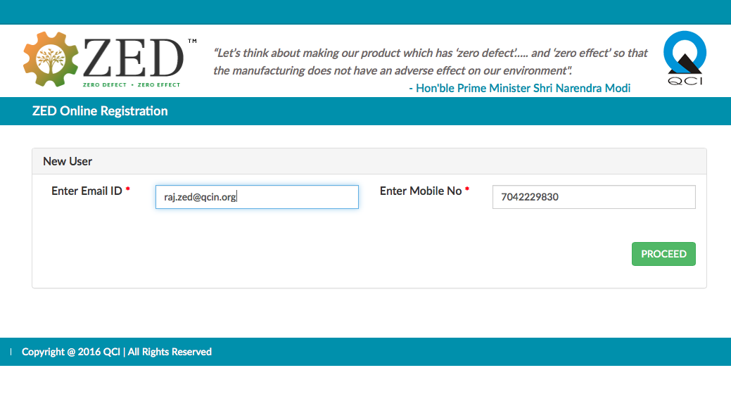
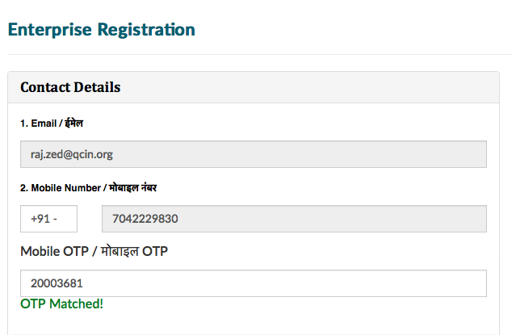
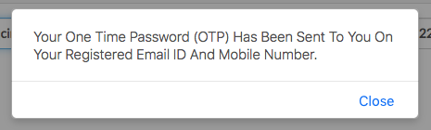
ZED Registration Portal

Slide 41
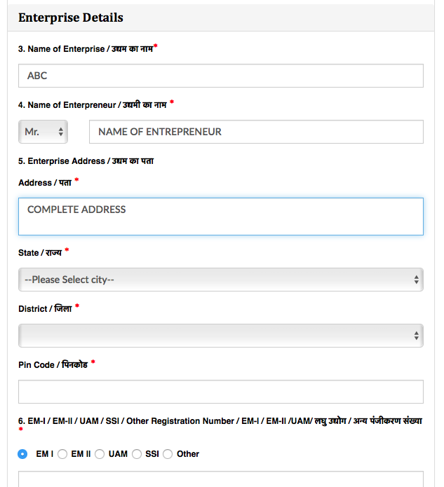
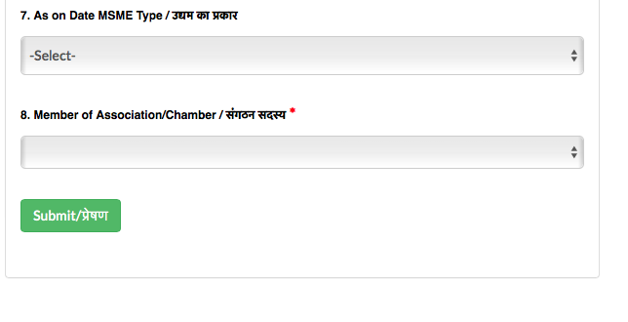
ZED Registration Portal

Slide 42
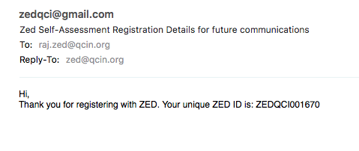
ZED Registration Portal

Slide 43
ZED Assessors Training Program
Day 1
Session 2
ZED Maturity Assessment Model
Introduction To Sectors Covered Under ZED
ZED Defence Model Introduction
5 Days Training Program

Slide 44
The ZED Maturity Assessment Model

Slide 45
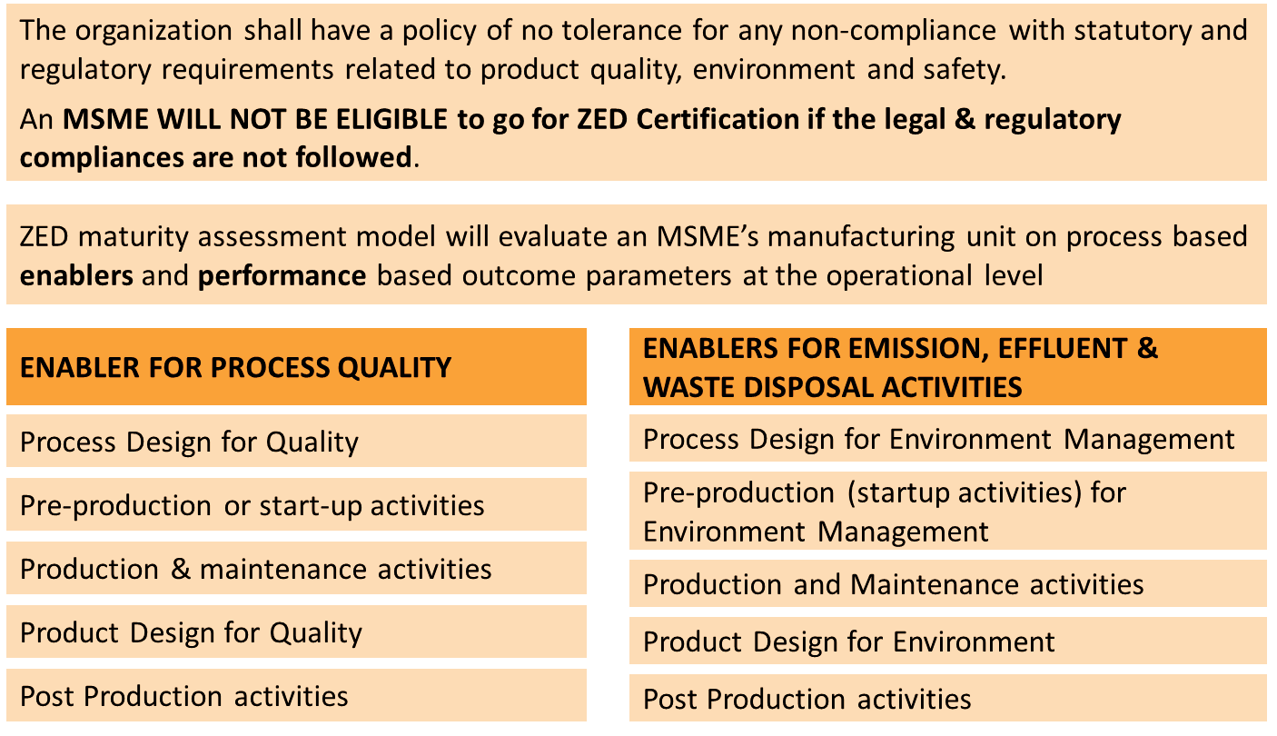
The ZED Model (1/2)

Slide 46
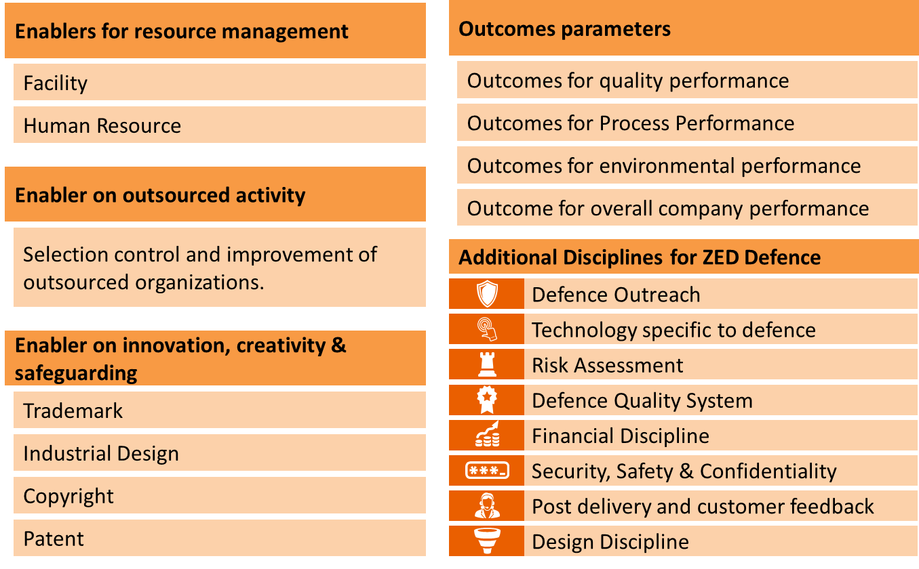
The ZED Model (2/2)

Slide 47
Organizational level Parameters
These aspects are only indicators and shall not be used for the assessment/rating of organizations.
Manufacturing capabilities
The organization shall acquire or develop manufacturing capabilities that enhance its ability to manufacture products in conformance with agreed specifications on a consistent basis taking into account all variations that may occur.
The organization shall regularly review and upgrade its manufacturing capabilities in line with changing customer expectations and technologies.
An organization meeting global manufacturing standards shall operate its manufacturing processes in a Lean - Six sigma environment, with ppm levels and operational efficiencies that match with the best in the world.

Slide 48
Organizational level Parameters
These aspects are only indicators and shall not be used for the assessment/rating of organizations.
Design capabilities
The organization shall develop or have access to design capabilities that will enable it to design, develop and constantly upgrade its products and service features to meet changing customer requirements and expectations.
An organization meeting global design standards shall operate in a highly innovative environment with a fully evolved design capability aided with IT enabled design tools and a clear understanding of design processes such as DFSS, QFD, DFMA and TRIZ.

Slide 49
Organizational level Parameters
These aspects are only indicators and shall not be used for the assessment/rating of organizations.
Quality/Environment/Safety Assurance Systems
The organization shall develop and maintain quality, environment and safety assurance management systems that enable it to identify and address customer, environment and employee needs in a systematic manner, with a fully evolved process management system, clearly defined objectives and performance indicators that are fully integrated and synchronized to cater to the identified needs.
The management system shall create an environment for the full realization of manufacturing capability, design capability and people and partnership potential to meet customer expectations, environment performance goals and safety standards.
An organization operating at global standards shall have a single integrated management systems, which enables agility, flexibility, risk based decision making and enhances stakeholder confidence.

Slide 50
Organizational level Parameters
These aspects are only indicators and shall not be used for the assessment/rating of organizations.
People development and engagement systems
The organization shall develop people competence and involvement commensurate with the identified organization capability to deliver product design, conforming product, environmental and safety performance at each maturity level.
A highly matured organization shall have developed an environment where people are empowered, motivated, fully engaged, feel responsible to innovate and take ownership of products and environmental performance.

Slide 51
Organizational level Parameters
These aspects are only indicators and shall not be used for the assessment/rating of organizations.
Standardization & Measurement systems for Quality and Environment
The organization shall develop and install dynamic framework of process and product standards and credible measurement systems that are aligned to provide true indicators of product and process performance, customer feedback, environmental impact and safety performance in real time, and enable quick and effective decision making.
A highly mature organization integrates all measurements with business information systems that enable full control on current and predicted performance through the use of intelligent measurement and statistical tools.

Slide 52
Organizational level Parameters
These aspects are only indicators and shall not be used for the assessment/rating of organizations.
Learning and Improvement systems
The organization shall develop a learning environment where management and people develop the habit of using and relying on data, trends and other internal and external information to understand and improve products, process performance, environmental and safety performance.
A highly mature organization encourages and practices the capturing, dissemination and use of knowledge generated from internal and external sources to make improvements and sustain its growth, quality levels and environmental performance.

Slide 53
Organizational level Parameters
These aspects are only indicators and shall not be used for the assessment/rating of organizations.
Legal compliances (Hygiene factor)
The organization shall have a policy of no tolerance for any non-compliance with statutory and regulatory requirements related to product quality, environment and safety.
A mature organization shall have an agile system of identifying new regulatory requirements, regularly performing compliance audits and checks that are reviewed and monitored by the Board or equivalent.

Slide 54
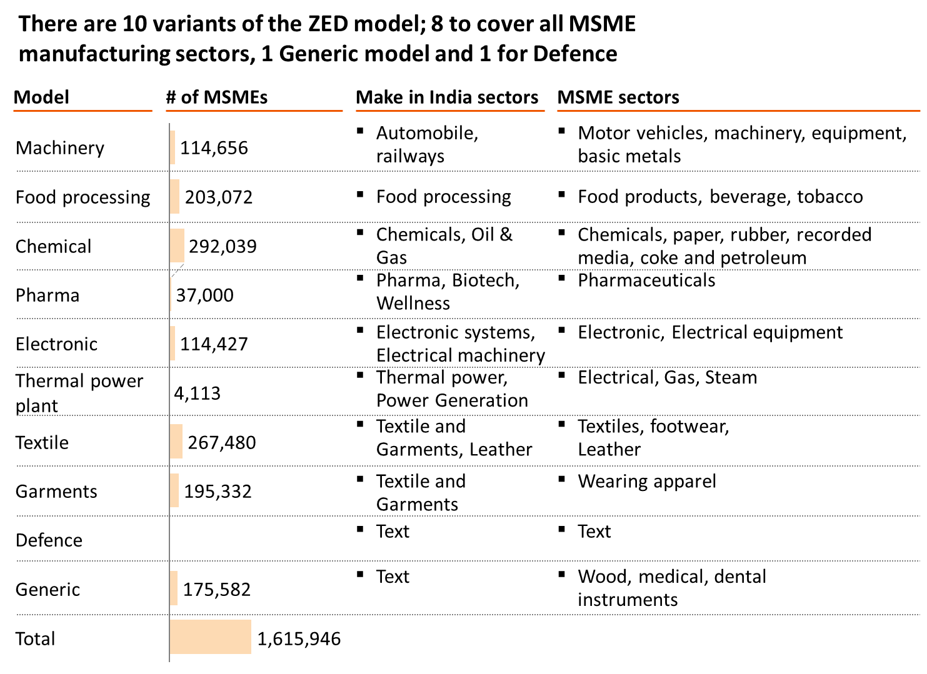

Slide 55
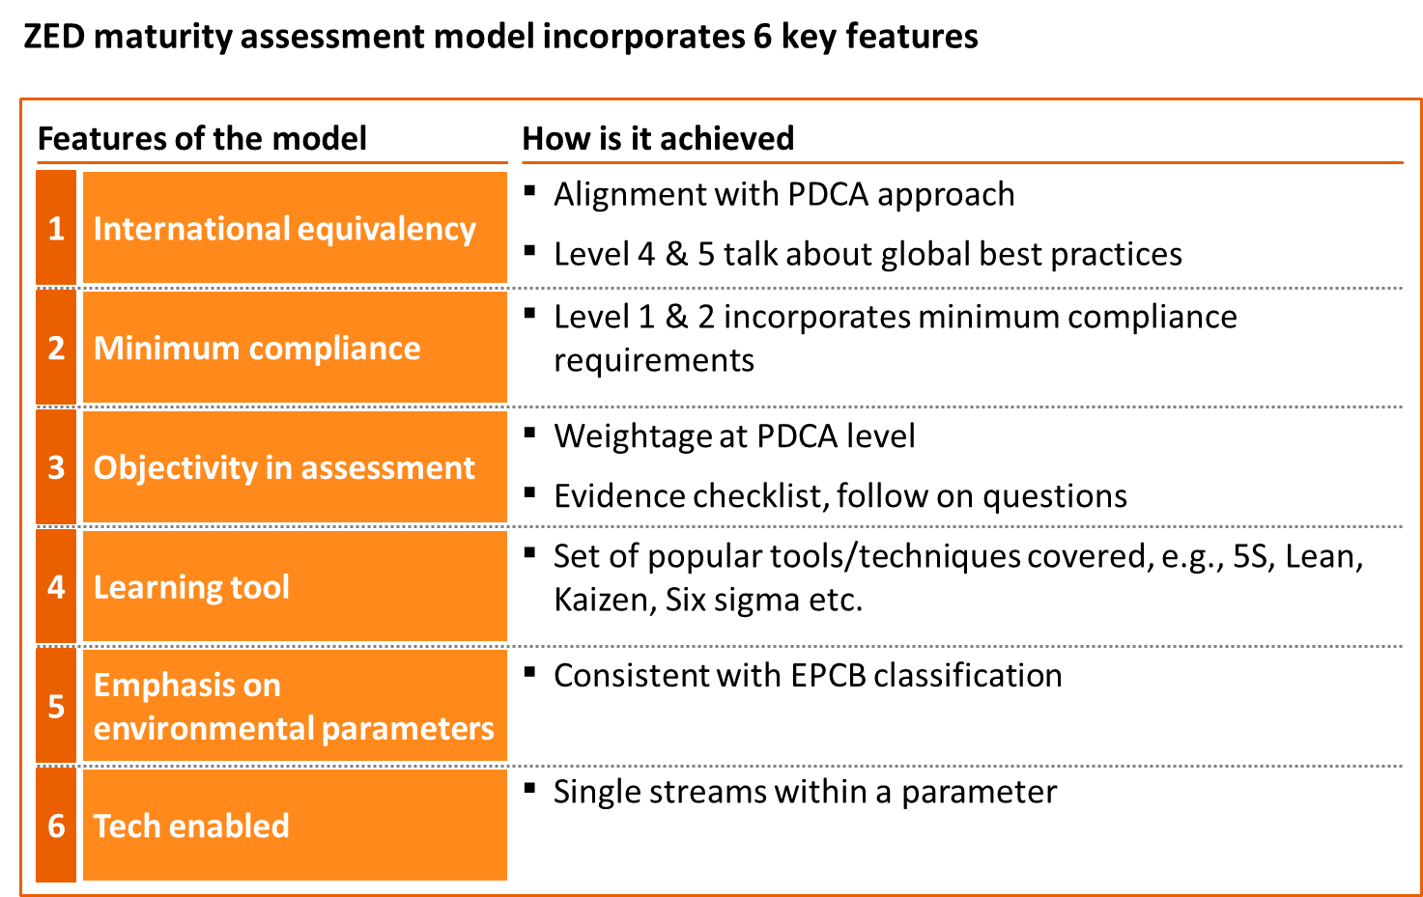

Slide 56
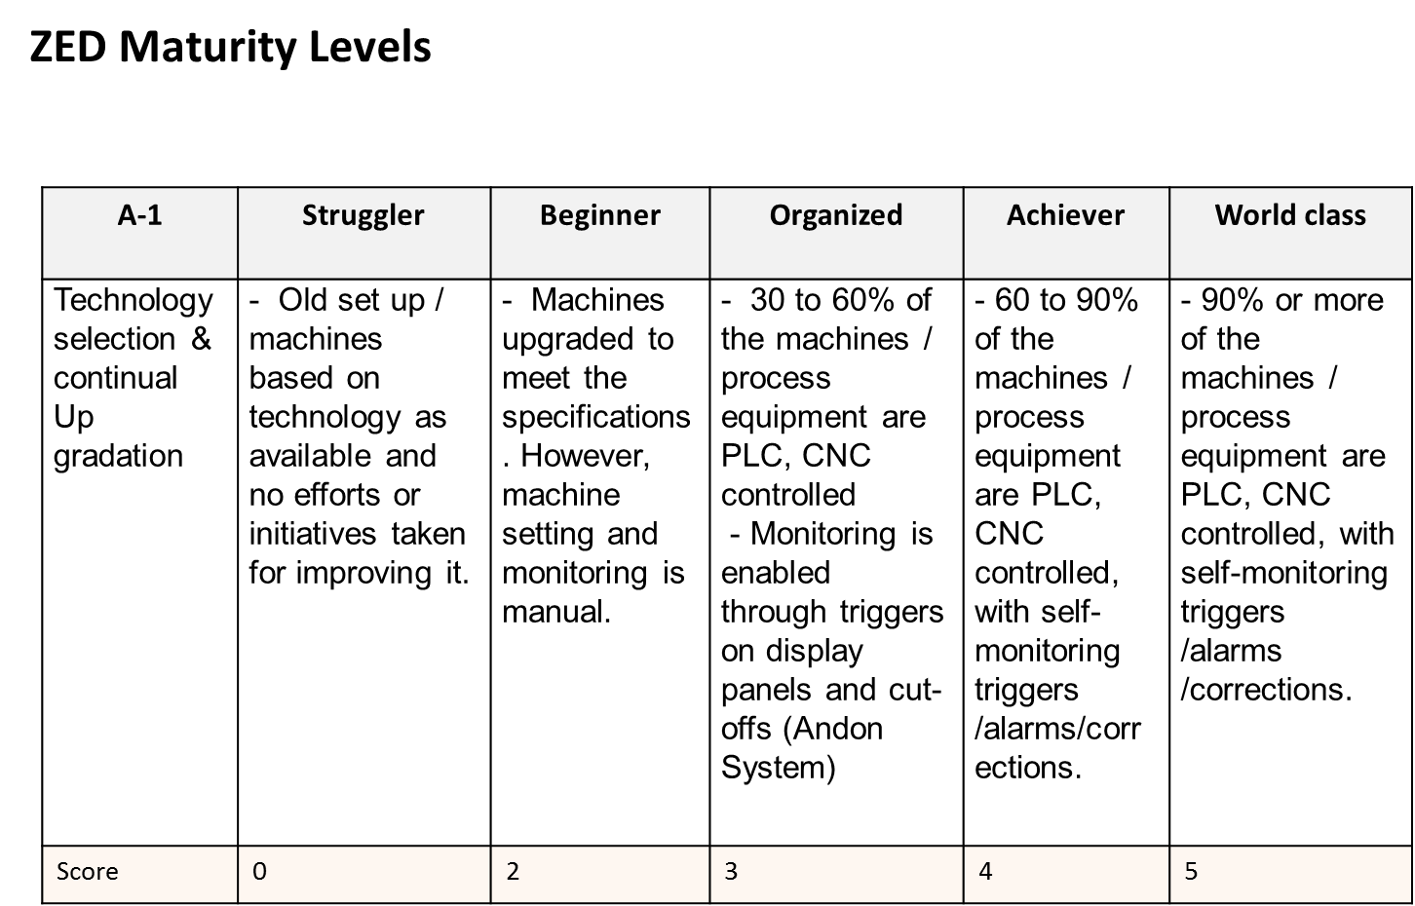

Slide 57
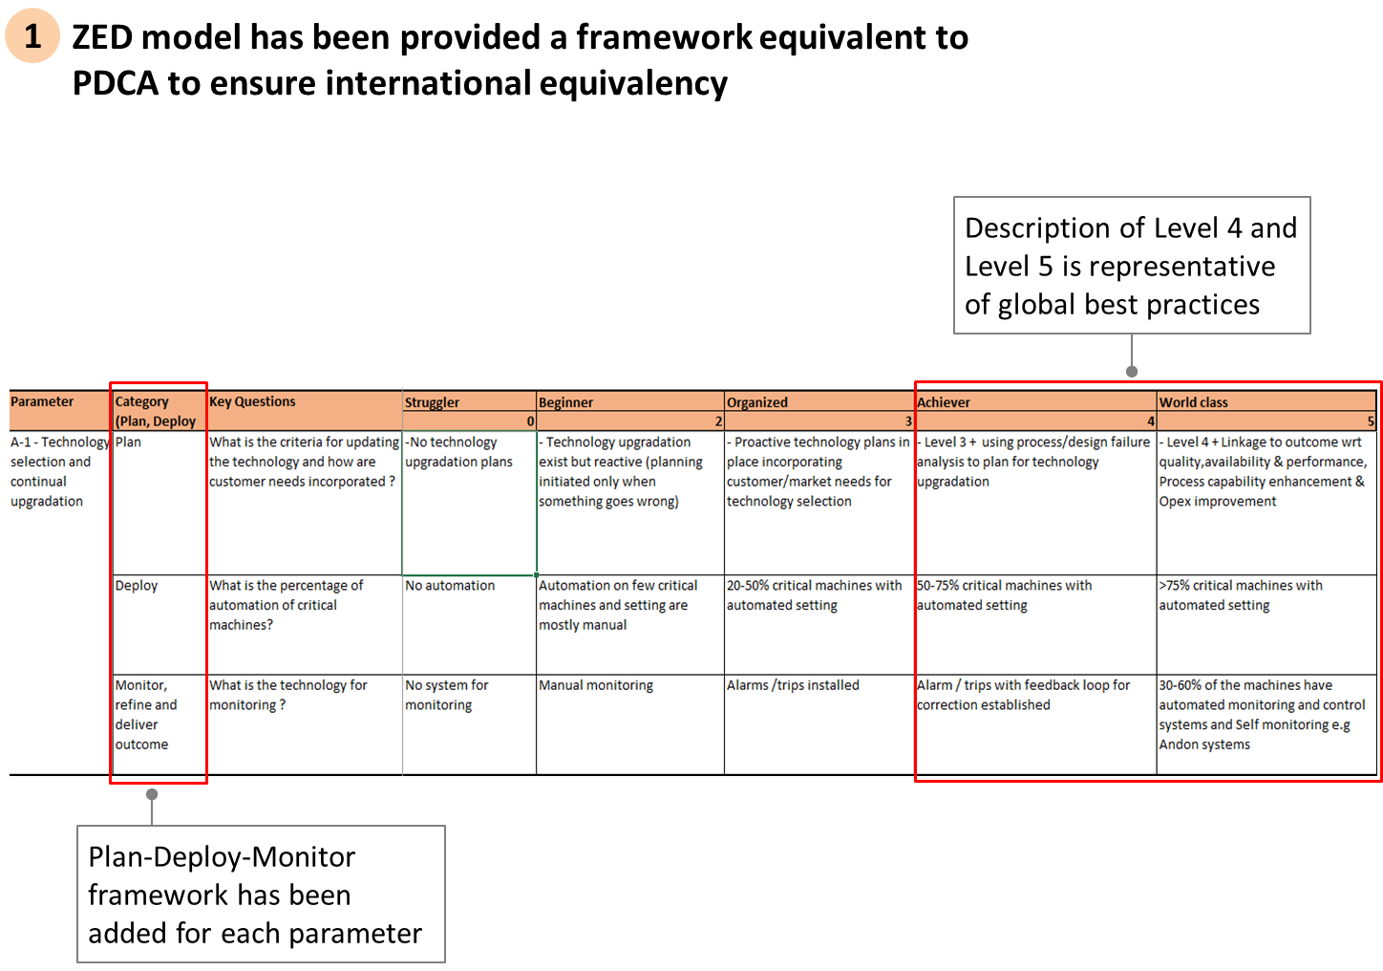

Slide 58
ZED PARAMETERS CLASSIFICATION

Slide 59
Day 1 Session III & IV – ZED Maturity Assessment Model ZED Deployment Disciplines

Slide 60



Slide 61
ZED Assessors Training Program
5 Days Training Program
Day 1
Session 3 - ZED Disciplines – Introduction to Operational Parameters

Slide 62
ZED Disciplines
No. | ZED Disciplines | Nos. of Parameters
1 | Production Management (Infrastructure) | 8
2 | Production Management ( Supply Chain) | 8
3 | Quality Management | 8
4 | Environment Management | 9
5 | Human Resource Management | 3
6 | Safety management | 2
7 | Intellectual Property Rights (IPR) | 4
8 | Design Management | 2
9 | Energy Management | 3
10 | Performance management / Overall Company Performance | 3
 | Total | 50

Slide 63
Day 1 Session III – ZED Maturity Assessment Model ZED Deployment Disciplines

Slide 64
1 . PRODUCTION MANAGEMENT (INFRASTRUCTURE)

Slide 65
ENABLERS & RESULTS

Slide 66
Transformational Change Process
Strategy
Systems & Processes
Activities
Results
ENABLERS
66
Notes:
TRANSFORMATIONAL CHANGE PROCESS

Slide 67
Enablers
Approach | Sound-- refinements embedded over time Integrate
Deployment | Implemented Systematic– structured, timely
Assessment and Refinement | Measurement-- Efficiency besides Effectiveness Learning & Creativity–internal and external good practice as source of learning Improvement & Innovation

Slide 68
Results
Relevance & Usability | Relevance, Integrity, Segmentation. Identifying targets Comparisons
Performance | Focus on key results

Slide 69
CAUSE AND EFFECT RELATIONSHIP
TECHNOLOGY
QUALITY MATERIALS
PRODUCT QUALITY
COMPTENCE
SOUND PROCESSES

Slide 70
1. PRODUCTION MANAGEMENT (INFRASTRUCTURE)
Production Management (Infrastructure) – 8 SUB PARAMETERS
No. | CLAUSE | TOPIC / SUB PARAMETERS
1 | C-1 | SWATCCH WORKPLACE
2 | C-2 | DAILY WORK MAANGEMENT
3 | K-1 | PLANT LAYOUT
4 | A-1 | TECHNOLOGY UPGRADATION
5 | A-3 | LOW COST AUTOMATION
6 | C-3 | PLANNED MAINTENANCE
7 | P-4 | OEE
8 | A-4 | WASTE MANAGEMENT

Slide 71
1.1 SWATCCH WORKPLACE

Slide 72
Objective
Create a clean, tidy, organized and cheerful workplace for improving productivity by involving all

Slide 73
5 ‘S’ & It’s Benefits
Topic
Understanding
Actions to be taken
Benefits
1 ‘S’
Sorting Out
Segregate Wanted & Un-Wanted things .
Remove Un-Wanted ones.
Decide on frequency of sorting.
Space Saving & Improvement in Work Efficiency .
2 ‘S’
Systematic
Arrangement
Decide the Place & Arranging in order.
A place for every thing and every thing in
it’s place.
Search Time reduced.
3 ‘S’
Shine Everything (Cleaning)
Dust Free Equipment / Work Place.
Make it easy to Clean.
Make it easy to Inspect Abnormalities.
Healthy Work environment
Abnormalities are Visible
& Corrected.
4 ‘S’
Standardization
Standard Procedure for all activities.
Review of Procedures and Work
Instructions at a Fixed Interval.
Achieving Higher Productivity and Better Quality.
5 ‘S’
Self Discipline
Forming the Habit / Culture.
Regular Training & Update.
Follow the decided things.
Habit of doing it Right
First Time and Every Time . Total Employees
Involvement.

Slide 74
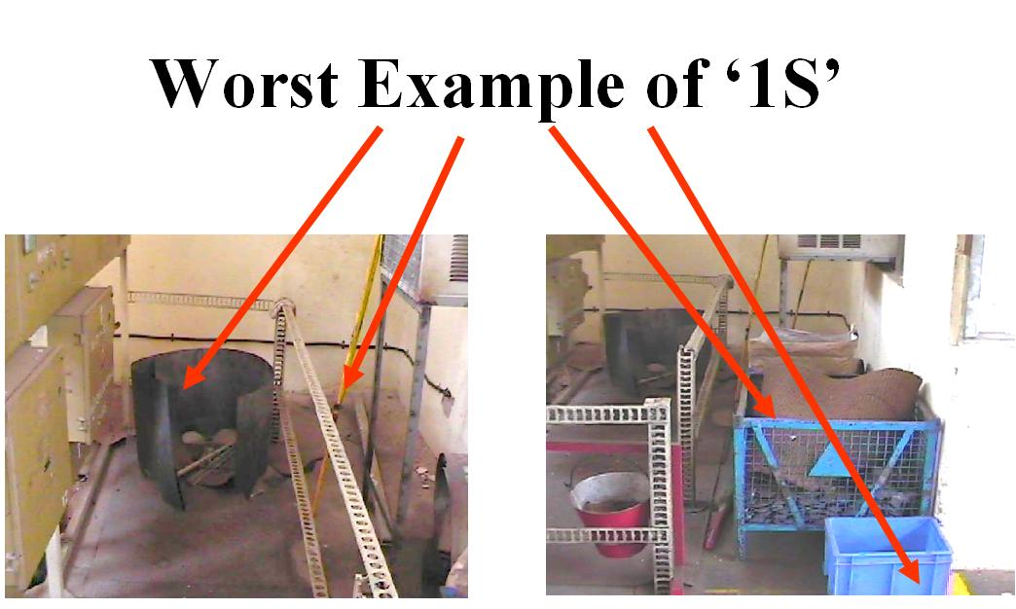
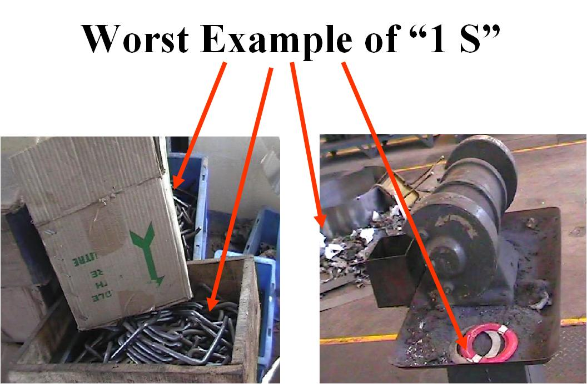

Slide 75
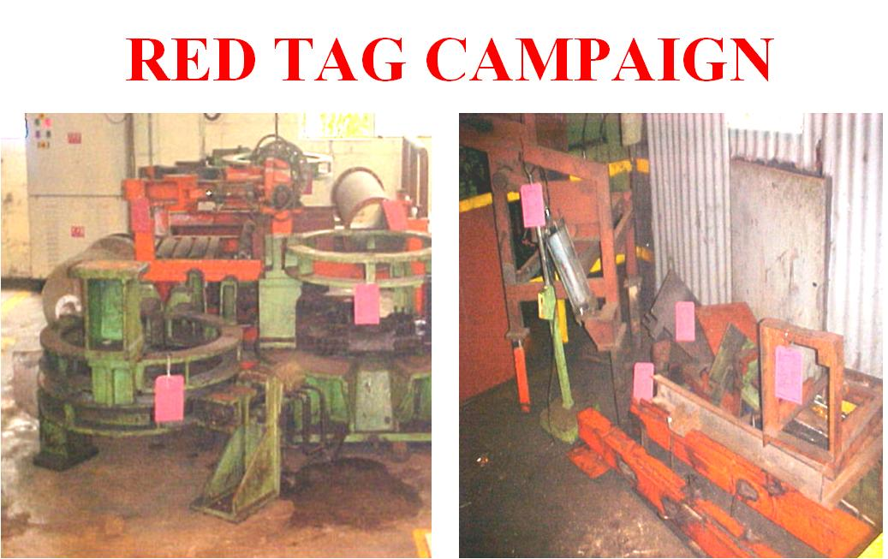
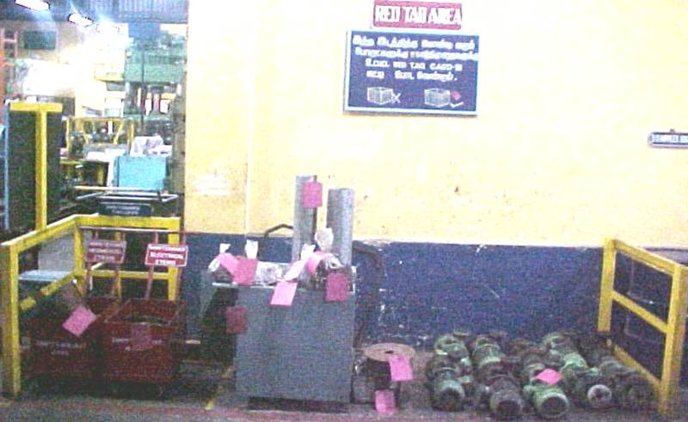

Slide 76
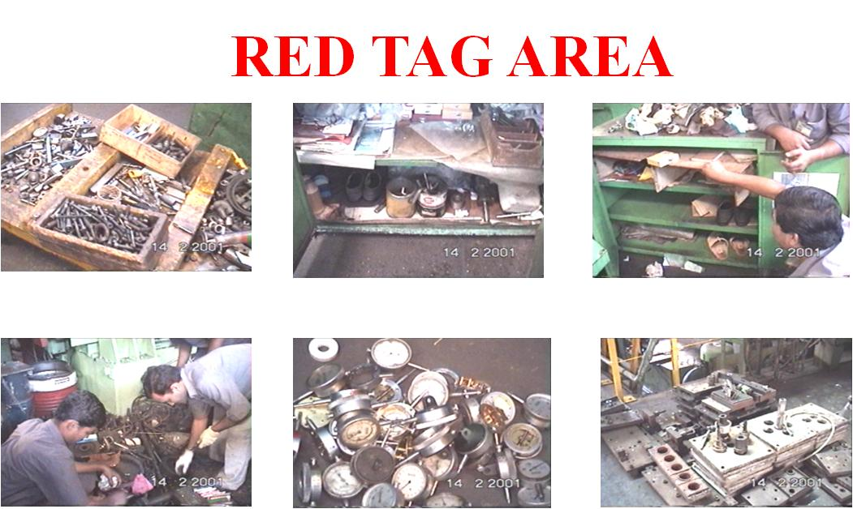

Slide 77
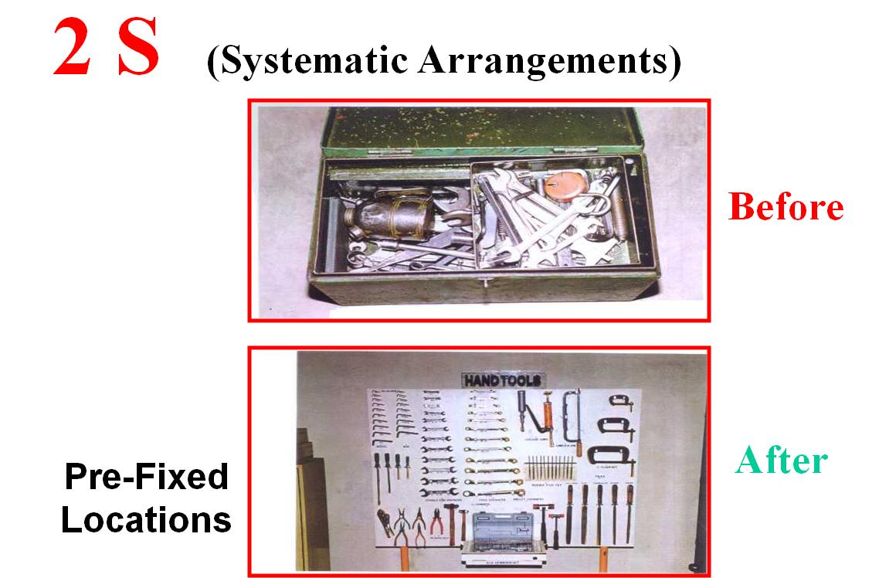

Slide 78
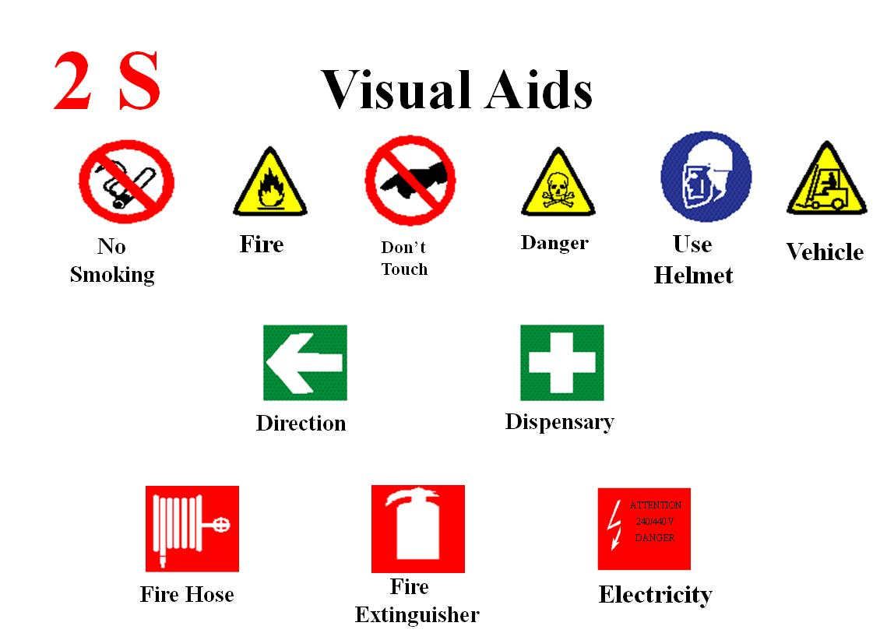

Slide 79
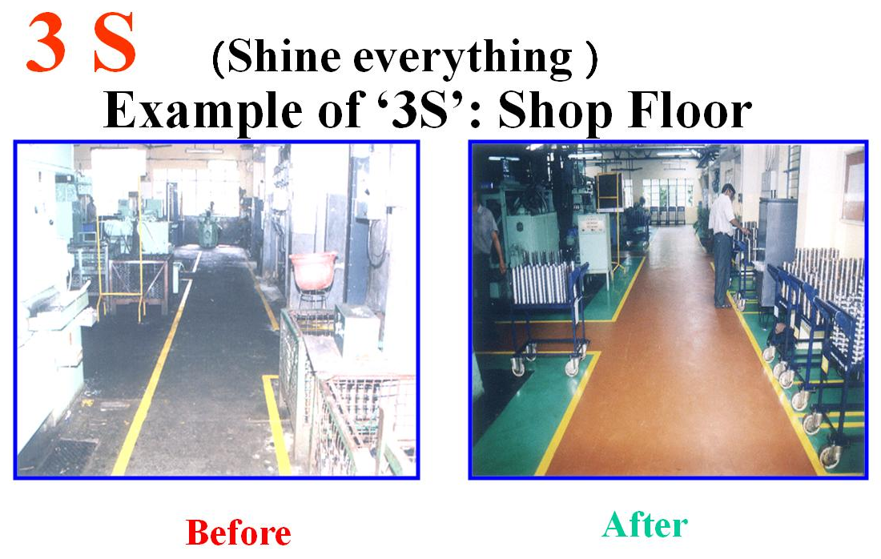

Slide 80
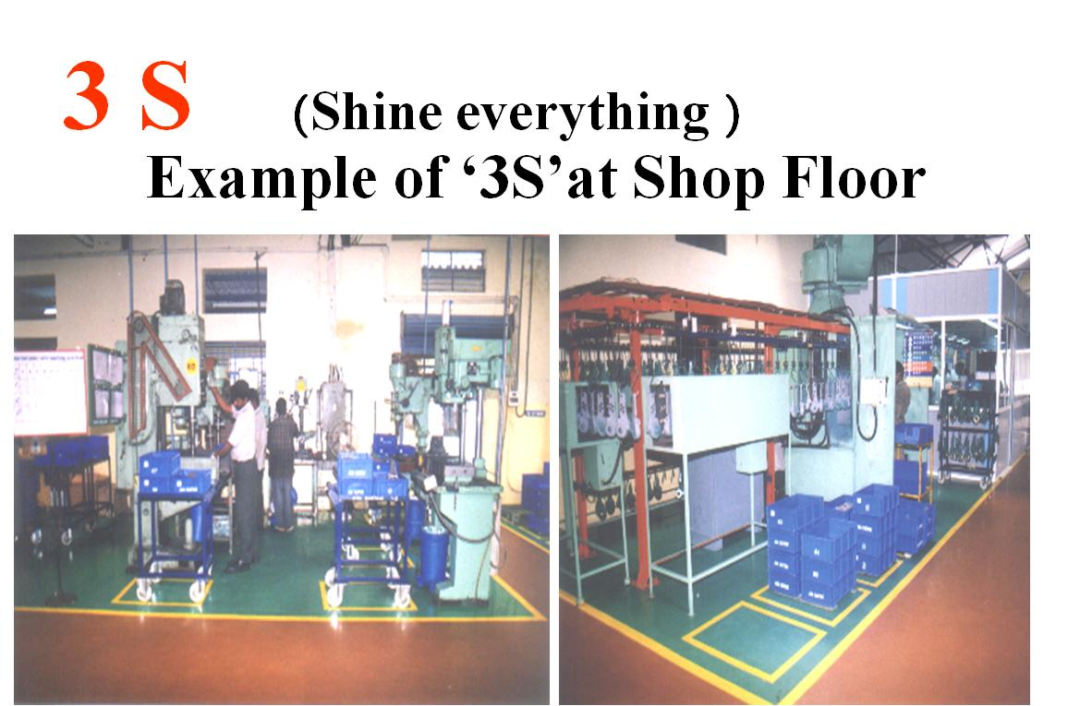

Slide 81
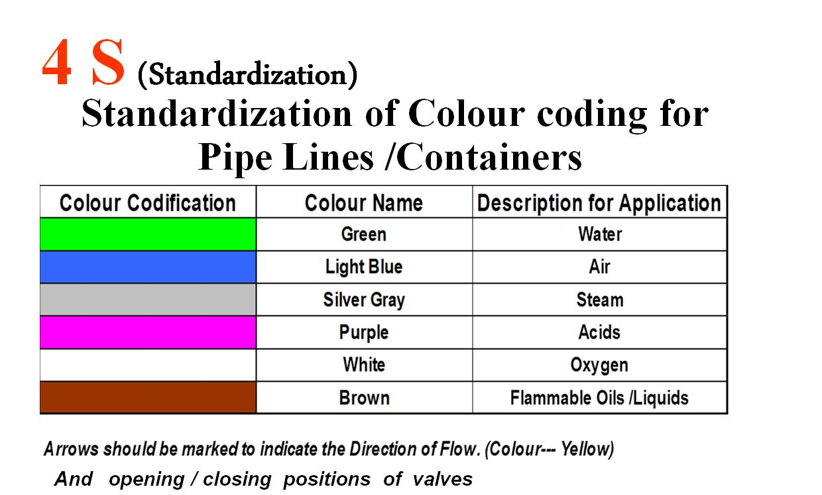
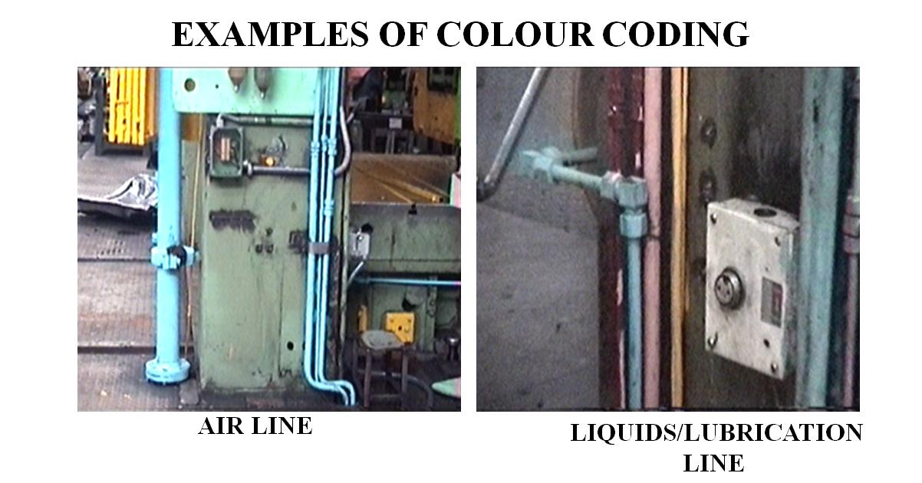

Slide 82
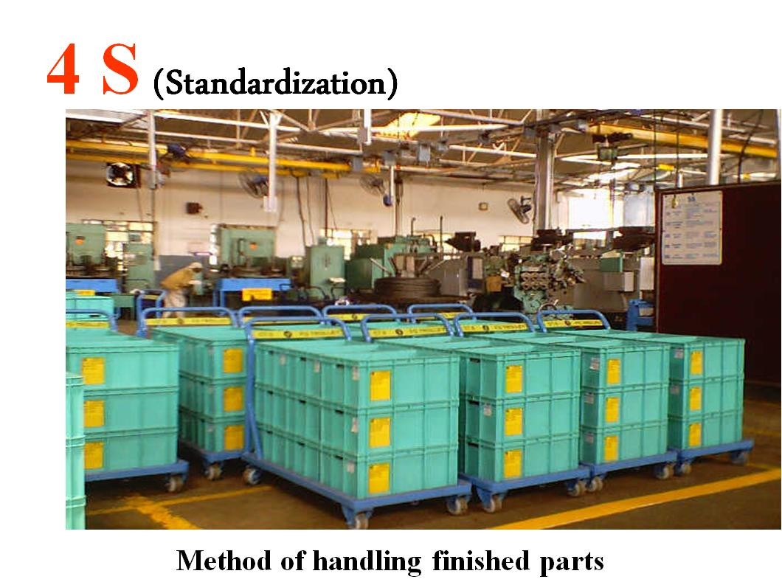

Slide 83
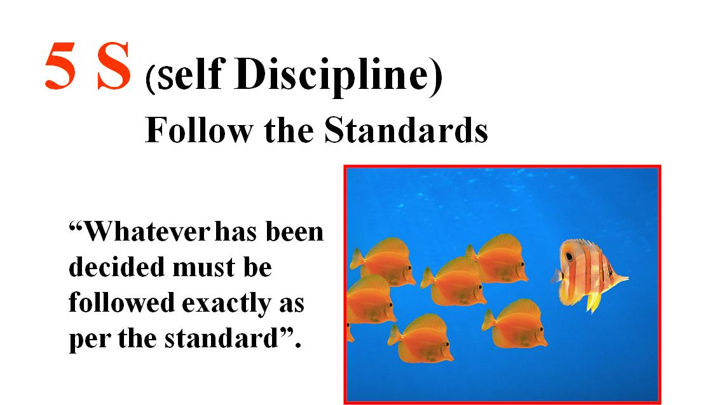

Slide 84
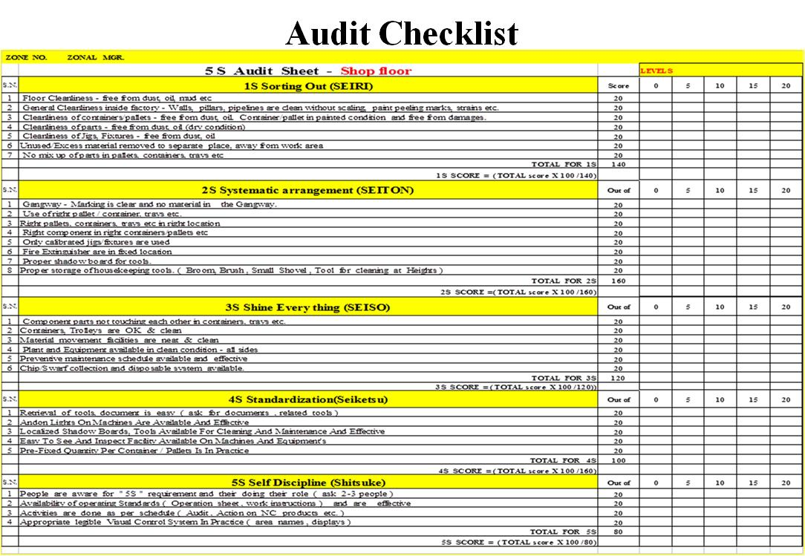
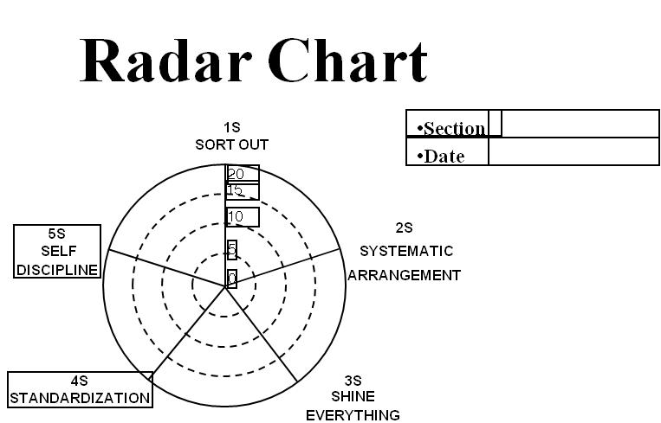
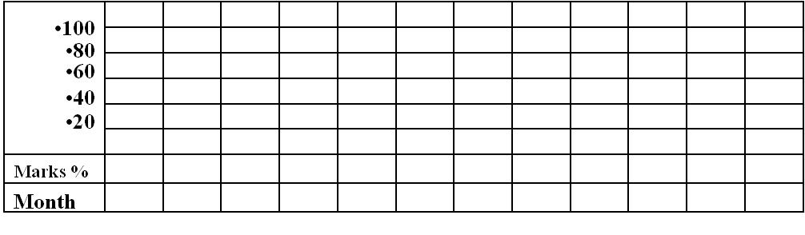

Slide 85
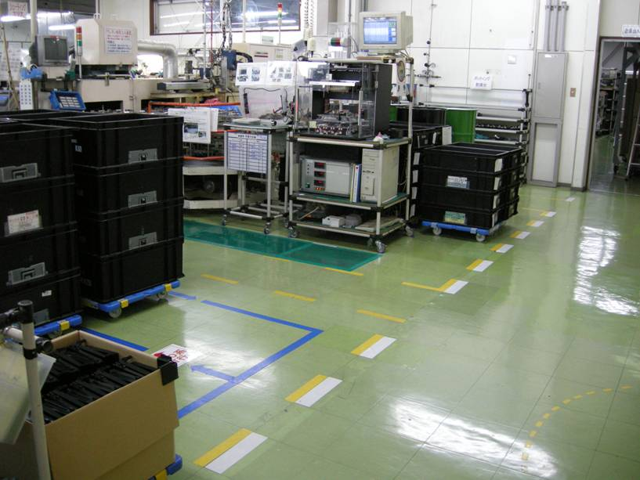
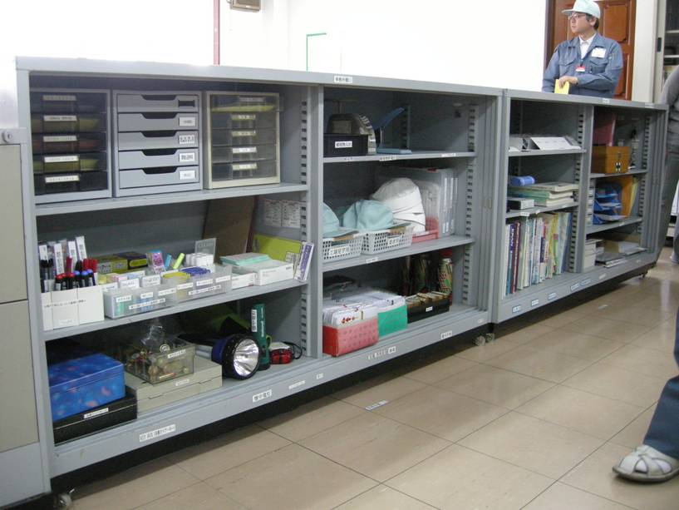
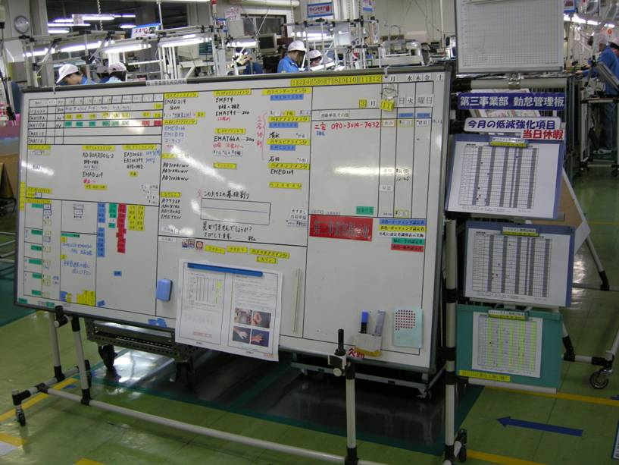
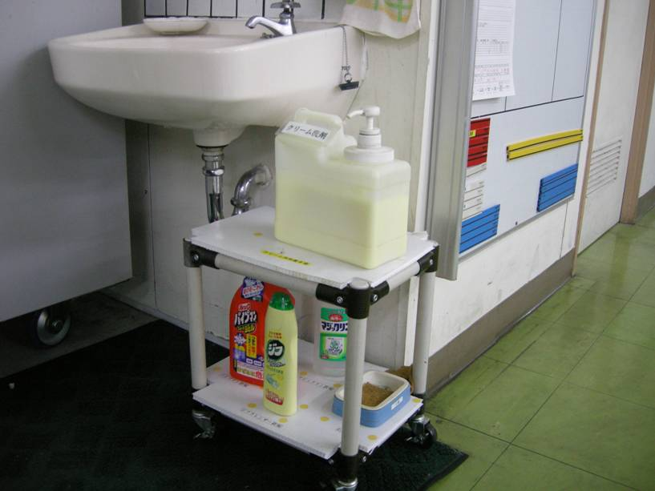
Swachh Company

Slide 86
ZED Maturity Level
C-1 | Struggler | Beginner | Organized | Achiever | World class
Swachh workplace (5S) | - Unclean work area with clutter all around (scrap material, tools etc.) and floor space unclean with oil, grime, etc. - No idea on its effect on safety and productivity | - 5 S seen as an improvement tool. Trainings /awareness created at all levels - Initiatives for 1S (Sort) is being implemented i.e. differentiating between the necessary and unnecessary to discard the unnecessary tools, parts, tools, machinery; defective products etc. | - Visual management is in place - Initiatives for 2S (ensuring everything has a designated place and the items are is in place) and 3S (ensuring workplace is clean and organized) are implemented across the company | - Standardization of the 5S procedures have been undertaken using various tools eg. job cycle charts, visual cues (e.g., signs, placards, display scoreboards),check lists | - ‘5 min’ ‘5 S’ activity is a routine - Continual Improvement in productivity and motivation is measured for PDCA
Score | 0 | 2 | 3 | 4 | 5

Slide 87
1 - 02 Daily Work Management (C-2)

Slide 88
Objective
Create a continually improving workplace for enhancing quality, productivity and safety by involving all on daily basis

Slide 89
ZED Maturity Level
C-2 | Struggler | Beginner | Organized | Achiever | World class
Daily works management | - Targets are set by fire fighting on day to day basis - QCD (Quality, Cost, Delivery) requirements are not set | - Factory has been divided into zone and leaders identified for DWM - Workers participation in DWM for problem resolution - DWM boards are in place | - QCD (Quality, Cost, Delivery) targets are met 70 - 80% - Systematic analysis of losses with appropriate initiatives identified and implemented with suitable action plan - PDCA cycle concept started for problem solving | - QCD (Quality, Cost, Delivery) targets are met ~80 - 95% - Information on Plan, Action and critical issues is displayed by Visual management - Workers participation in day to day basis increased by SGA/QC/ suggestions / schemes/ simplification | - QCD (Quality, Cost, Delivery) targets are met 95% or more - Continual improvement on SOPs, reduction in variability and OEE improvement
Score | 0 | 2 | 3 | 4 | 5

Slide 90
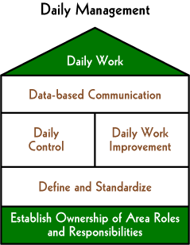
Daily Work Management

Slide 91
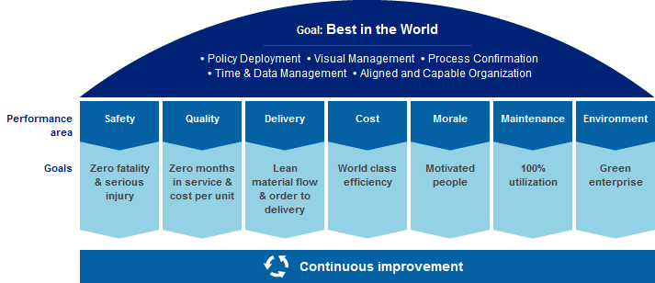
Daily Work

Slide 92
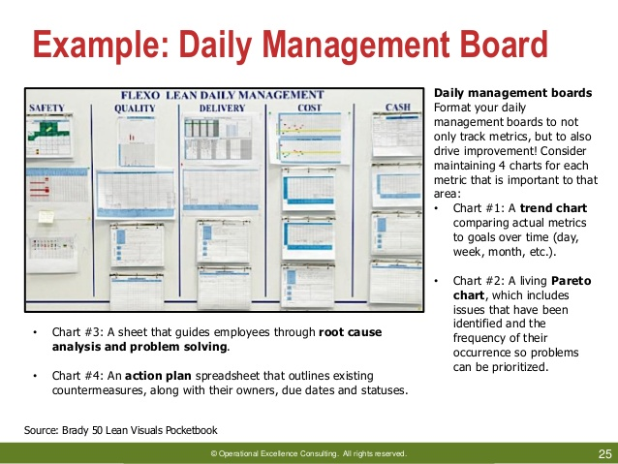
Daily Work Management Board

Slide 93
1 - 03 Plant Layout (K-1)

Slide 94
Objective
Planning for the location of all machines, utilities, employee workstations, material storage areas, pathways, service areas, space necessary for the operation of processes, and for the flow of materials and people movement within plant area

Slide 95
ZED Maturity Level
K-1 | Struggler | Beginner | Organized | Achiever | World class
Plant layout | - Machines/ equipment are laid out as per availability of space - There is no consideration of process flow as part of plant layout decisions. | - Wastes attributed to unplanned layout are identified. People are trained and teams are formed for improvements. - Efforts are to ensure layout conducive to linear material flow | - Layout considers flow from raw material receipt to dispatch point with straight line pathways. - Layout supports accessibility of machines from point of maintainability - Layout supports full segregation of material based on grades and types, rework, reject status on the shop floor | - Visual management of total flow and plant layout exist - Reduction in material distance, time and manpower is measured and reviewed for continual improvement | - Regular monitoring of benefits of improved layout is done for PDCA
Score | 0 | 2 | 3 | 4 | 5

Slide 96
JIT Layout
Reduce waste due to movement
JIT Layout Tactics
Build work cells for families of products
Include a large number operations in a small area
Minimize distance
Design little space for inventory
Improve employee communication
Use Poka-yoke (fail safe) devices
Build flexible or movable equipment
Cross-train workers to add flexibility

Slide 97
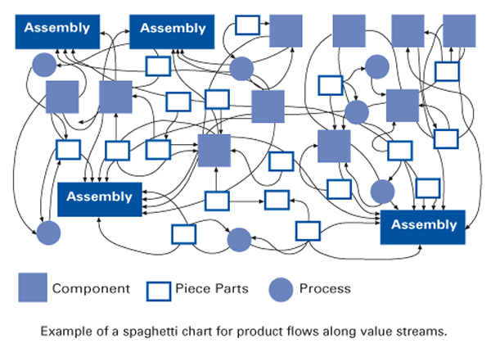
Randomly developed Layout

Slide 98
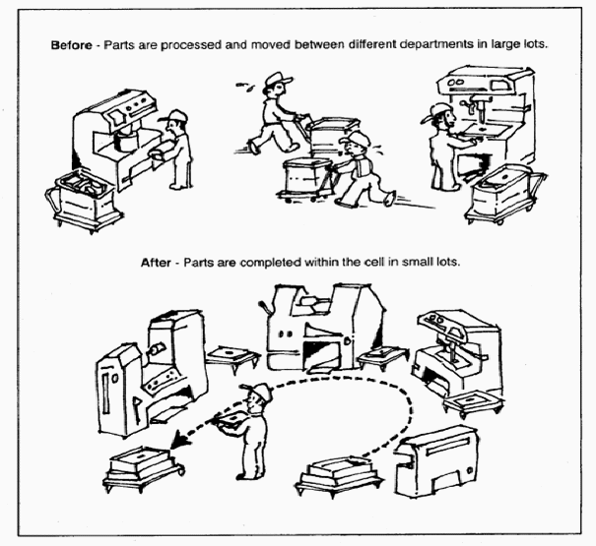
Types of Layout
Islands (isolated processes)
Connected Islands
Connected islands with full work control
Cells

Slide 99
1 - 04 Technology Upgradation (A-1)

Slide 100
Objective
Design, develop & upgrade or source technology commensurate with product design that meets changing customer and market need on a consistent basis

Slide 101
ZED Maturity Level
A-1 | Struggler | Beginner | Organized | Achiever | World class
Technology selection & continual Up gradation | - Old set up / machines based on technology as available and no efforts or initiatives taken for improving it. | - Machines upgraded to meet the specifications. However, machine setting and monitoring is manual. | - 30 to 60% of the machines / process equipment are PLC, CNC controlled - Monitoring is enabled through triggers on display panels and cut-offs (Andon System) | - 60 to 90% of the machines / process equipment are PLC, CNC controlled, with self-monitoring triggers /alarms/corrections. | - 90% or more of the machines / process equipment are PLC, CNC controlled, with self-monitoring triggers /alarms /corrections.
Score | 0 | 2 | 3 | 4 | 5

Slide 102
1 - 05 Low Cost Automation (A-3)

Slide 103
Objective
Replacing manual efforts with alternate mechanized operations developed locally to reduce quality variations, time & cost of operations

Slide 104
ZED Maturity Level
A-3 | Struggler | Beginner | Organized | Achiever | World class
Low Cost Automation | - There is no emphasis or awareness on low cost automation | - Low cost automation is done to improve productivity primarily by Management | - Concept of low cost automation is brought into small group activity and the group uses various tools (eg. Kaizen sheets, one point lessons) | - Productivity (Production per FTE) is measured and have improved to the extent of 50% or more of internal targets | - Productivity (Production per FTE) is measured and have improved by upto 80% or more of internal targets - Continuous exercise undertaken for identification and implementation of opportunities for productivity improvement
Score | 0 | 2 | 3 | 4 | 5

Slide 105
What is Low Cost Automation?
Low Cost Automation(LCA) is the introduction of simple pneumatic, hydraulic, mechanical and electrical devices into the existing production machinery, with a view to improving their productivity.
LCA is a technology that creates some degree of automation around the existing equipment, tools, methods, and people, using mostly standard components available in the market.
LCA allows low investment so that the pay back period is short, typically of the order of a few weeks to less than a year.

Slide 106
Advantages of LCA
Low investment: While capital equipment is expensive and has long payback period, LCA is built around existing resources. Hence, the investments required are lower and payback period short.
Labour productivity can be enhanced using LCA.
Low Capacity: Expensive automation needs large turnover to be cost-effective. LCA can be viable at low volume of production, typically in SMEs.
Less Wastage: Better utilization of material, less Work In Progress (WIP) and less rejection. LCA can help curtail such wastage.

Slide 107
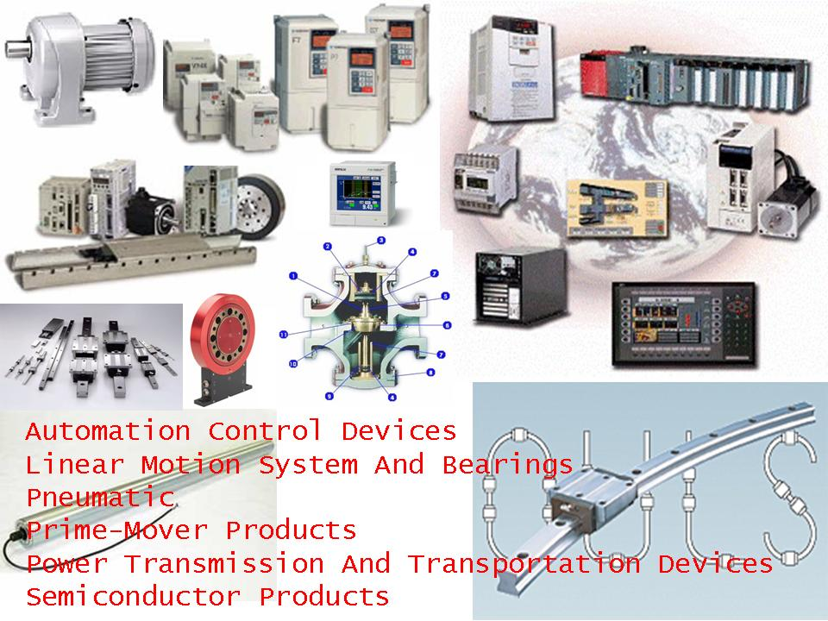
LCA Mechanisms

Slide 108
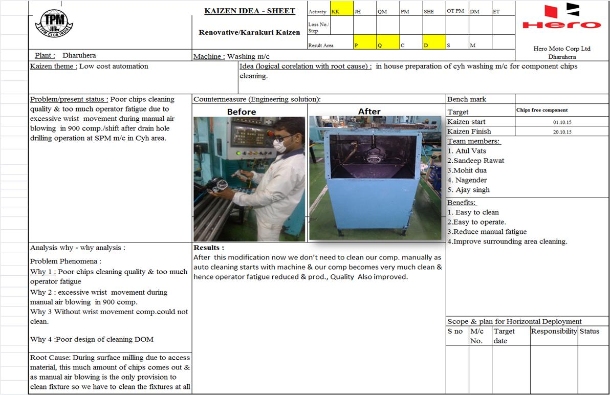

Slide 109
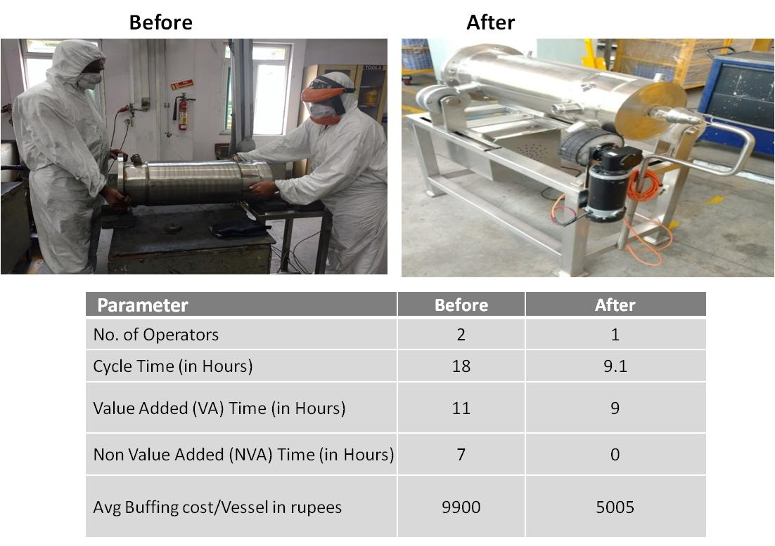

Slide 110
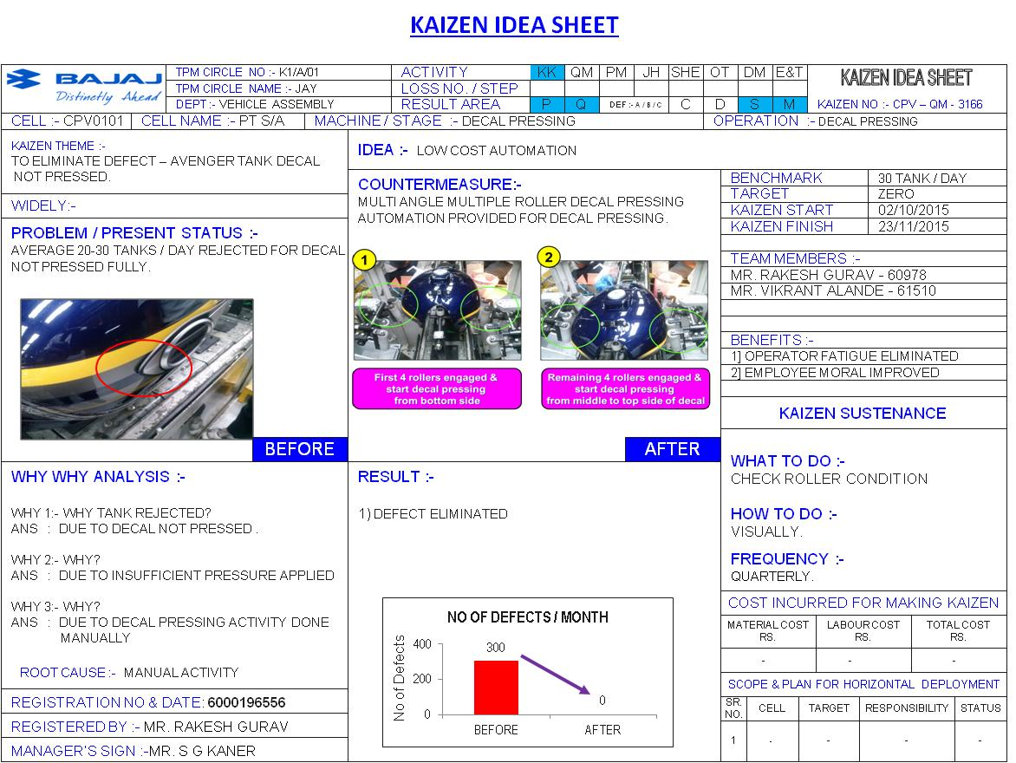

Slide 111
Exercise-1
Pertaining to the following requirements:
Swacch Workplace
Daily Work Management in a SME
Plant Layout
Technology Upgradation
Low cost Automation
Develop:
Three main questions to assess the requirement
Three main steps to implement

Slide 112
1 - 06 Planned Maintenance (C-3)

Slide 113
Objective
Scheduled maintenance at fixed intervals, ensuring that the equipment or item is operating reliably at reduced cost and downtime

Slide 114
ZED Maturity Level
C-3 | Struggler | Beginner | Organized | Achiever | World class
Planned maintenance | - No system of planned maintenance. Equipment are repaired as and when breakdown occurs | - Planned maintenance system in place. | - Planned maintenance system in place. Adherence to schedule is 50%-80% - Step 1, 2 & 3 of autonomous maintenance are implemented and are taking place regularly in the organisation | - Planned maintenance system in place. Adherence to schedule is 80-95% - Measures undertaken to eliminate repeat failures - Step 4 & 5 of autonomous maintenance are implemented in the organisation | - Planned maintenance system in place. Adherence to schedule is >95% - Machine breakdowns have been reduced by 5% in the last one year - Step 6 & 7 of autonomous maintenance are implemented in the organisation
Score | 0 | 2 | 3 | 4 | 5

Slide 115
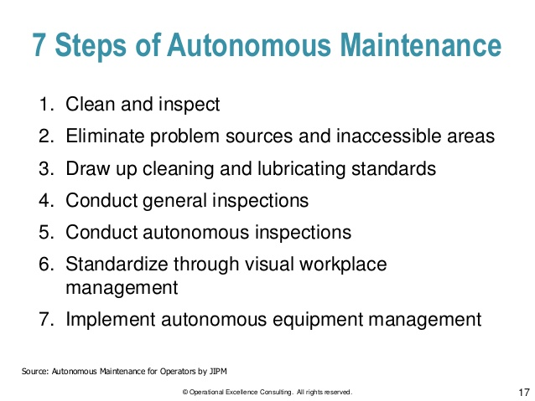

Slide 116
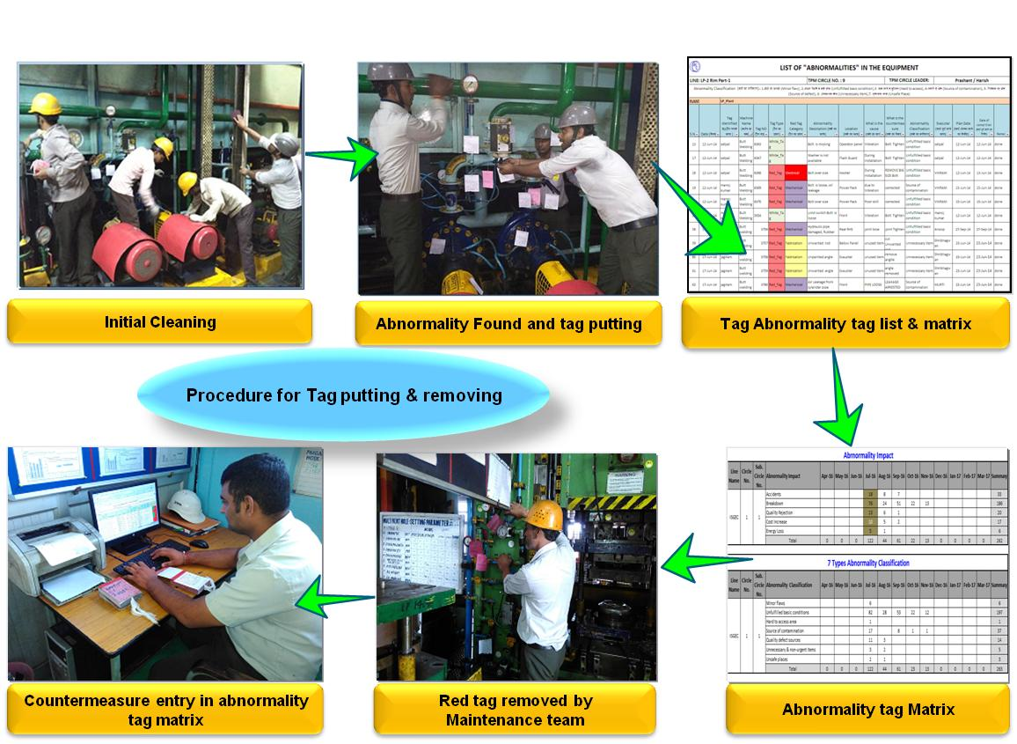
Step – 1 Clean and inspect

Slide 117
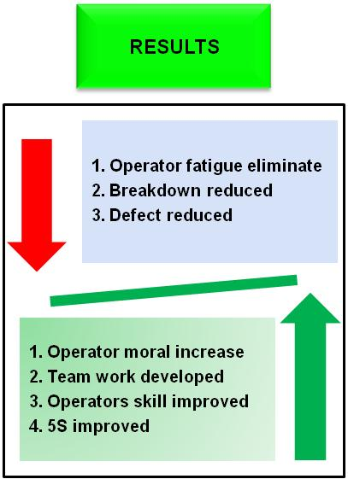
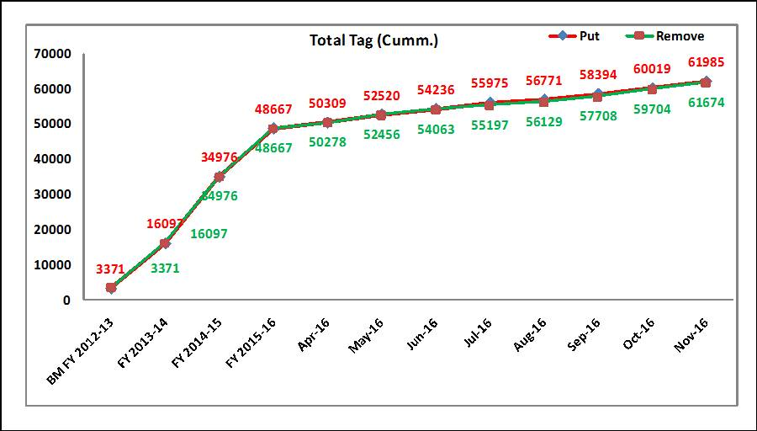

Slide 118
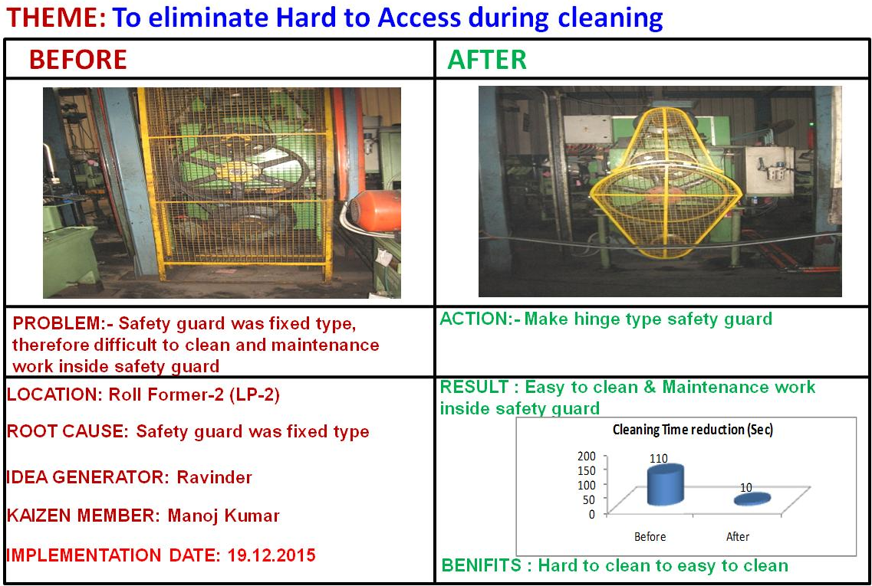
Step – 2 Countermeasure against Inassessible Area

Slide 119
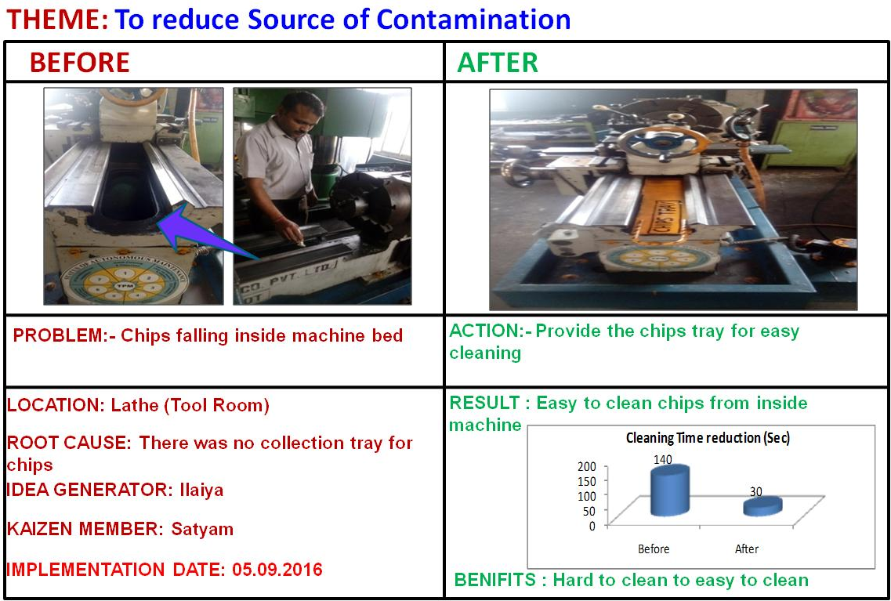
Step – 2 Countermeasure against Source of Contamination

Slide 120

Step – 3 CLITA Standard

Slide 121

Step – 3 Visualization

Slide 122

Step – 4 Conduct General Inspection

Slide 123

Step – 4 Conduct General Inspection

Slide 124
1 - 07 Overall Equipment Effectiveness (P-4)

Slide 125
Objective
To assess the impact of planned maintenance

Slide 126

Six Big Losses of Equipment

Slide 127


Slide 128

Overall Equipment Effectiveness (OEE)
Overall Equipment Effectiveness (OEE) is the key metric to measure the performance of individual equipment. However, when machines operate jointly in a manufacturing line, OEE alone is not sufficient to improve the performance of the system as a whole
Example: One company
producing deep drawn steel
components using a power
press, which is having
-Equipment Availability:50%
-Performance Rate: 70% &
-Quality Rejection Rate: 20%
OEE = A X P X Q
= 0.5 X 0.7 X 0.8 =28%

Slide 129
OEE (Example)
Availability | A | Calendar Time : 10,080 minutes (24 hrs total available time per day on 7 days)
 | B | Planned Production Time : 6,600 minutes (there was demand that could be run) |  |  |  | Planned Downtime: -No Sched / Breaks -Scheduled Maint
 | C | Actual Production Time : 5,665 minutes |  |  | Availability Losses: -Breakdowns -Changeover / Idling
Performance | D | True North Output: 5,665 mins / 0.2 mins per unit = 1,133 units |  |  |  | Total Effective Equipment Performance Loss
 | E | Actual Output : 872 units |  | Performance Losses: -Minor stops -Reduced speed
Quality | F | Actual Output : 872 units |  | Overall Equipment Effectiveness Loss
 | G | Good Product : 835 units | Quality Losses: -Scrap / Rework
TEEP
OEE
TEEP = Availability x Performance x Quality
= C/A x E/D x G/F x 100%
OEE = Planned Availability x Performance x Quality
= C/B x E/D x G/F x 100%
Total Avail Rate: | 5,665 mins / 10,080 mins x 100 = | 56.2%
Performance Rate: | 872 units / 1,133 units x 100 = | 77.0%
Quality Rate: | 835 units / 872 units x 100 = | 95.8%
TEEP | 53.8% x 89.4% x 95.1% = | 41.4%
Planned Availability Rate: | 5,665 mins / 6,600 mins x 100 = | 85.8%
Performance Rate: | 872 units / 1,133 units x 100 = | 77.0%
Quality Rate: | 835 units / 872 units x 100 = | 95.8%
OEE | 90.0% x 89.4% x 95.1% = | 63.3%

Slide 130
ZED Maturity Level
P-4 | Struggler | Beginner | Organized | Achiever | World class
Overall Equipment Effectiveness | Less than 30% | 30-60% | 60-65 % | 65-85% | >85 %
Score | 0 | 2 | 3 | 4 | 5

Slide 131
Waste Management (A-4)
1 - 08

Slide 132

Work place design for reducing Muda, Mura, Muri (3M) in operations.
Muda : Waste (7 Wastes)
Overburdened
Muri: Strain / Overburden
Mura-: Imbalance / Unevenness
Waste
Unevenness

Slide 133
ZED Maturity Level
A-4 | Struggler | Beginner | Organized | Achiever | World class
Waste Management | - No awareness on waste & its effect on profitability or customer | - Awareness on waste & its effect on profitability - Preliminary measures of waste reduction implemented with no tracking mechanism in place | - Value analysis of manufacturing activities for waste elimination is done through group activity and detailed action plans are in place along with targets and review cadence - Project is meeting targets of 50%-70%and improvement measures are initiated | - Waste reduction project is meeting at least 70%-90% of its targets and is showing continuous improvement since inception | - Waste reduction project is meeting targets by ~90% or more
Score | 0 | 2 | 3 | 4 | 5

Slide 134

How to reduce Waste (Muda)?
1. Detect Waste
2. Eliminate Waste
WASTE
3. Prevent Waste

Slide 135
Muda : Waste
MUDA stands for eliminating non value added activities and there are seven types of MUDA identified in shop floor:
MUDA of production (over production)
MUDA of stock (over stock)
MUDA of conveyance (transport)
MUDA of waiting
MUDA of operation
MUDA of workmen movement
MUDA of production of inferior goods

Slide 136
Muri : Strain
MURI stands for any activity that exceeds actual capacity of 4M (man, machine, material & method)
Example:
Press over load due to double panel loading in the die
Double sheet feeding in shearing machine
Use of 2.5 T fork lift instead of 5 T fork lift
Lifting two dies at time with EOT crane

Slide 137


Muri : Strain
Use of 2.5 T fork lift instead of 5 T fork lift
2.762 Ton with 2.5T forklift
2.762 Ton with 5T forklift
WRONG
CORRECT

Slide 138
Mura : Imbalance
MURA stands for any activity that contains inconsistency or ineffective utilization
Example:
Unequal allocation of work to operators

Slide 139


Mura : Imbalance
Unequal allocation of work to operators
The work load for the last operator is not balanced with other two operators

Slide 140
Exercise-2
How to implement following enablers in a SME:
1. Planned Maintenance
2. OEE
3. Waste Management
Develop practical action plan and schedule for progressing from level 1 to level 3 maturity
Specify the current state and target state with timeline
How will you ensure you have reached desired state?
What action will you take if not attained the target?

Slide 141
ZED Assessors Training Program
5 Days Training Program
Day 1
Session 4 - Production Management (Supply Chain)

Slide 142
Day 1 Session IV – ZED Maturity Assessment Model ZED Deployment Disciplines

Slide 143
2. PRODUCTION MANAGEMENT (SUPPLY CHAIN)

Slide 144
2. Production Management
(Supply Chain)
# | Clause | Topic
1 | K-2 | Materials Management
2 | K-3 | Material Handling
3 | B-2 | Supplier Development
4 | M-1 | Outsourcing
5 | E-1 | Transport & Storage
6 | E-2 | Timely Delivery
7 | E-3 | Customer Education
8 | E-4 | Customer Servicing

Slide 145
2 - 01 Materials Management

Slide 146
Objective
Facilities for the safe and systematic storage under controlled conditions, of raw materials, consumables, spares, in-process material, semi-finished products and assemblies, finished products, packaged products, with due identification, traceability systems to permit easy access and retrieval

Slide 147
ZED Maturity Level
K-2 | Struggler | Beginner | Organized | Achiever | World class
Materials Management | - Storage activities are seen as a transient point - Higher inventory levels are maintained to ensure there are no stock-outs. | - Stores department is seen as part of materials management. - Materials management team analyses demand consumption pattern to decide the stock levels - Activities between stores and purchase are synchronized | - Segmentation of stores carried out based on various factors - Storage systems ensuring ease of handling; FIFO, Indexing and binning are in place. - The decided stock levels are maintained and reviewed to ensure reduction in inventory | - Based on the segmentation of stores the layout of store is decided. - Concept of de-centralization of stores with a view to minimize the non-value added activities is discussed and finalized. - Visual Management with color coding in place. - The reduction in inventory at all stages such as raw material , WIP, Finished good, etc. is measured and reviewed for improvement | - The reduction in inventory has led to improved Inventory Turnover ratio consistently on year to year basis. - The visual management ensures instant material irretrievability by anybody.
Score | 0 | 2 | 3 | 4 | 5

Slide 148
2 - 02 Material Handling

Slide 149
Objective
People’s participation in planning and execution of policies that relate to or impact their work. Employee involvement presupposes the organization’s commitment to improving the partnership and developing shared understanding between the people and their managers

Slide 150
ZED Maturity Level
K-3 | Struggler | Beginner | Organized | Achiever | World class
Material handling systems | - Material handling is predominantly manual - Not seen as activity that can improve productivity and quality | - Material handling is taken as management focus area to reduce cost, eliminate movement related quality issues - Team organized to identify handling issues each stage i.e. eg. Material receipt , Inspection/acceptance, Storage etc. | - Quality defects /damages attributed to handling are identified and corrective actions taken - Improvement goals and plans are made with the team after awareness training and participation | - Material handling systems have been designed commensurate with products sensitivity and incidence of handling defects Benefits are being measured in terms of : - Response and retrieval time - Productivity of inventory - Elimination of unnecessary operations - Maximized floor space utility - Security and safety - Good house keeping | - Automated storage/retrieval system in place - Continual PDCA for sustaining and improvements
Score | 0 | 2 | 3 | 4 | 5

Slide 151

Time Spent in Material Handling

Slide 152
Exercise-3
Pertaining to the following requirements:
1. Materials management
2. Material Handling
Develop:
Three main questions to assess the requirement
Three main steps to implement

Slide 153
2 – 03 Supplier Development

Slide 154
Objective
Identify & develop supplier capability to enable supply of consistent conforming products and services to the organization and for outsourcing non-core activities while meeting the quality and reliability parameters

Slide 155

Improvements done at Steel Supplier

Slide 156
ZED Maturity Level
B-2 | Struggler | Beginner | Organized | Achiever | World class
Supplier development | - No systematic vendor selection process in place (Purchases are made based on day to day requirements without any system, may result in stock-outs/firefighting) | - Suppliers are evaluated and approved based on a systematic process | - Performance management systems for vendor evaluation in place | - System in place to help suppliers improve their capabilities | - Performance management is used for business allocation
Score | 0 | 2 | 3 | 4 | 5

Slide 157
2 - 04 Outsourcing

Slide 158
Objective
Organization’s system for identification, evaluation, selection, monitoring of performance, providing feedback to outsourced organizations with the objective of enhancing value of partnership to both

Slide 159
ZED Maturity Level
M-1 | Struggler | Beginner | Organized | Achiever | World class
Outsourced activities : Selection, control and improvement | - No formal selection process in place to select vendors for outsourcing. - Work outsourced without any evaluation of skills and resources. | - Defined selection process in place but not followed effectively. - The performance of only key vendors is reviewed. | - Basic outsourcing strategy in place that aids identifying areas for outsourcing - A formal selection and evaluation process for vendors exists and periodic evaluation as per the evaluation process is done - Service level agreements are in place. | - Vendor considered as Partners and works with them to evaluate the current processes to identify improvement opportunities such as technology changes etc. - Frequent dialogue and collaborative discussions for product / service improvements and sharing of knowledge | - Highly mature outsourcing strategy and implementation framework - The strengths of outsourcing partners used for innovation in products. Value addition to the organisation in terms of technology, process enhancement and competitiveness by knowledge sharing.
Score | 0 | 2 | 3 | 4 | 5

Slide 160
2 - 05 Transport and Storage

Slide 161
Objective
Facilities & methods for storage and transportation are appropriate to ensure product quality is retained till it reaches the customer

Slide 162
ZED Maturity Level
E-1 | Struggler | Beginner | Organized | Achiever | World class
Transportation and storage | - No awareness on the appropriate conditions for transportation or storage of products based on the type of product | - Appropriate conditions for transportation or storage of products based on the type of product are documented but are not followed | - Facilities are partially available for the storage/transportation of products under appropriate conditions. | - Facilities are available for the storage/transportation of products under appropriate conditions but on exceptional basis are not followed | - Facilities are available for the storage/transportation of products under appropriate conditions and is followed 100% - No customer complaints with respect to transportation/storage
Score | 0 | 2 | 3 | 4 | 5

Slide 163
2 - 06 Timely Delivery

Slide 164
Objective
Adherence to delivery timelines

Slide 165
ZED Maturity Level
E-2 | Struggler | Beginner | Organized | Achiever | World class
Timely delivery | - No process in place to ensure adherence to delivery timelines | - Process in place to ensure adherence to delivery timelines but not followed | - Process in place to ensure adherence to delivery timelines and followed upto ~50% cases | - Adherence to delivery timelines in upto ~70% cases | - Adherence to delivery timelines in upto >85% cases
Score | 0 | 2 | 3 | 4 | 5

Slide 166
OTIF
How do you measure OTIF?
A delivery day and/or time must be on an order.
Track your performance on each order. (You may be able to extract this data from your computer system) However, technology isn't necessary to track OTIF. You could simply use a check mark for "on-time" and an 'X' for "not on-time." This could be marked on the dispatch sheet and then entered up on an excel Spreadsheet. Take this opportunity to include the reason any items were not dispatched.
Work out the result as a percentage of the total number of orders.

Slide 167
How to improve OTIF?
Have a daily meeting to discuss outstanding issues that are affecting OTIF, based on “Fails” from the previous day. Whatever the solution, the fact remains that several departments are now united in solving a performance problem that affects them all.
Concentrate on your rate of improvement. Be prepared to change or challenge the way you do things. If the definition of Insanity “doing things the same way and expecting a different result” holds true, then changes to procedures and processes will be necessary to achieve higher results.

Slide 168
2 - 07 Customer Education

Slide 169
Objective
Awareness is given to the user for proper use of the product during its life cycle to ensure that it performs as per requirement

Slide 170
ZED Maturity Level
E-3 | Struggler | Beginner | Organized | Achiever | World class
Customer Education for product usage Maintenance and service | - No defined process for customer training or dedicated team for product demonstrations | - Defined process for customer training partially in place. - Small team in place for product demonstrations and customer training but team does not use any tools for training | -Defined processes and appropriately sized teams for product demonstrations and customer training. - Usage of traditional mediums like user manuals for educating customers about proper usage of the product during its life cycle. | - Usage of videos and other mediums (white papers, eBooks and newsletters etc.) for product demonstration/installation to customers - But no other forums to solve customer pain points on real time basis. | - Dedicated and skilled team for product demo to the customers at the time of delivery &installation. - Uses technologies (webinars, eBooks, e-learning courses) to highlight and solve customer pain points and educate customers.
Score | 0 | 2 | 3 | 4 | 5

Slide 171
2 - 08 Customer Servicing

Slide 172
Objective
Have processes to provide service to the customer, to meet his post supply needs

Slide 173
ZED Maturity Level
E-4 | Struggler | Beginner | Organized | Achiever | World class
Customer Servicing | - No defined plan/process for customer servicing. | - Defined plan/process for customer servicing partially in place and are being followed | '- Comprehensive plan/process defined for customer servicing and is implemented - Targets as laid out in the plan are being met at least 50%-70% | - Targets as laid out in the plan are being met at least 70-90% - Defined service levels are reviewed on a consistent basis and initiatives are undertaken to improve it | - Targets as laid out in the plan are being met at least >90% - Defined service levels are reviewed on a consistent basis and initiatives are undertaken to optimise processes
Score | 0 | 2 | 3 | 4 | 5

Slide 174
Exercise-4
How to implement following enablers in a SME:
1. Supplier Development
2. Outsourcing
3. Transport & Storage
4. Timely Delivery
5. Customer Education
6. Customer Servicing
Develop practical action plan and schedule for progressing from level 1 to level 3 maturity
Specify the current state and target state with timeline
How will you ensure you have reached desired state?
What action will you take if not attained the target?

Slide 175
Exercise-4
How to implement following enablers in a SME:
1. Supplier Development
2. Outsourcing
3. Transportation & Storage
4. Timely Delivery
5. Customer Education
6. Customer Service
Three main questions to assess the requirement
Three main steps to implement

Slide 176
ZED Assessors Training Program
5 Days Training Program
Day 2
Session 1 – Quality Management – 8 Sub Parameters

Slide 177
Day 2 Session I – ZED Maturity Assessment Model ZED Deployment Disciplines

Slide 178
3. Quality Management
# | Clause | Topic
1 | A-2 | Process Capability
2 | B-1 | Process Validation
3 | C-4 | Process Control
4 | O-1 | Outgoing Quality
5 | O-2 | In-house Quality
6 | O-3 | Field Performance Quality
7 | P-2 | Scrap Reduction
8 | P-3 | Improvement in Process Capability

Slide 179
3 - 01 Process Capability Assessment & Enhancement

Slide 180
Objective
Realize the process potential, stabilizing and continuously improving process performance

Slide 181
ZED Maturity Level
A-2 | Struggler | Beginner | Organized | Achiever | World class
Process Capability Assessment & Enhancement | - No concept of process capability / process performance assessment e.g. no control charts | - Process performance for a 25%-50% of processes is monitored through control charts but no action | - Process performance for 50%-75% of processes is monitored through control charts but no action | - Process performance for 75%-90% of processes is monitored through control charts - Results are used for process corrections/ improvements in certain cases | - Process performance for 90% or more of processes is monitored through control charts - Results are used for process corrections/ improvements in all cases
Score | 0 | 2 | 3 | 4 | 5

Slide 182


Slide 183
Process Capability Ratio
Process Capability Ratio, C_{p}, is the tolerance width divided by 6 standard deviations (process variability).
Upper specification - Lower specification
6σ
C_{p} =
Notes:
33

Slide 184
Process Capability Index, C_{pk}
Process Capability Index, C_{pk}, is an index that measures the potential for a process to generate defective outputs relative to either upper or lower specifications.
=
x – Lower specification
3σ
=
Upper specification – x
3σ
C_{pk} = Minimum of
,
We take the minimum of the two ratios because it gives the worst-case situation.
Notes:
33

Slide 185
Effects of Reducing Variability on Process Capability
Nominal value
Six sigma
Four sigma
Two sigma
Lower
specification
Upper
specification
Mean
Notes:
22

Slide 186
Control Charts

Slide 187

Examples of Control Charts
Notes:
http://www.robertluttman.com/vms/Week5/page6.htm
Statistical Thinking Tools-Control Charts for the Average
Date:February 12, 2001
Bob Luttman, Robert Luttman & Associates
Example of a control chart that has points outside the UCL. This process may need to be reworked. The problem is becoming worse, you can see that the data is consistently above the mean towards the end of the data.

Slide 188

Examples of Control Charts
Notes:
Processes and Process Variability, Date accessed: Feb 12, 2001
http://www.sytsma.com/tqmtools/ctlchtprinciples.html
Example of a process that is in-control.

Slide 189
3 -02 Process Validation

Slide 190
Objective
Proving through suitable tests and confirmations on the product that the process has the capability to deliver design requirement on a consistent basis

Slide 191
ZED Maturity Level
B-1 | Struggler | Beginner | Organized | Achiever | World class
Process validation | - No system to validate that process is meeting specification and quality requirements | - Processes are documented but no validation processes in place | - Processes are documented and followed and process validation undertaken for critical/key processes | - Validation process such as Proto type manufacturing, First piece validation or Pilot manufacturing is in place and is undertaken for all processes | - Systematic Process Validation undertaken for all processes with 100% control over the at least 80% of the process and at least 80% of the finished products
Score | 0 | 2 | 3 | 4 | 5

Slide 192
3 -03 Process Control

Slide 193
Objective
Application of statistical quality control method, to monitor and control processes, to identify variances as a basis for continual improvement

Slide 194
ZED Maturity Level
C-4 | Struggler | Beginner | Organized | Achiever | World class
Process Control | - Process Quality Plan (Control Plan) does not exist. | - Process Quality plan (control plan) in the making/ quality plan exists but is not followed | - Process Quality Plan (control plan) followed but only for ~30% of the processes or less . | - Critical processes identified and process Quality Plan (control plan) followed for all critical process | - Process Quality Plan (Control plan) followed for all process.
Score | 0 | 2 | 3 | 4 | 5

Slide 195
3-04 Outgoing Quality

Slide 196
Objective
Outgoing (customer end) quality performance level / % improvement

Slide 197
ZED Maturity Level
O-1 | Struggler | Beginner | Organized | Achiever | World class
Outgoing (at customer end) quality performance level | - Outgoing quality level is 2% or more | - Outgoing quality level is less than 2% | - Outgoing quality level is 5000 ppm or less or >50% customers rate the organisation as meeting their expectations | - Outgoing quality level is 1000ppm or less or >50% customers rate the organisation as top quartile | - Outgoing quality level is 100ppm or less or >50% customers rate the organisation as top decile
Score | 0 | 2 | 3 | 4 | 5

Slide 198
Exercise-5
Pertaining to the following requirements:
1. Process Capability
2. Process Validation
3. Process Control
4. Outgoing Quality
Develop:
Three main questions to assess the requirement
Three main steps to implement

Slide 199
3-05 In-house Quality

Slide 200
Objective:
In-house quality performance level / % improvement

Slide 201
ZED Maturity Level
O-2 | Struggler | Beginner | Organized | Achiever | World class
In-house quality performance level (first pass) | - In process manufacturing quality level is 5% or more | - In process manufacturing quality level is less than 5% | - In process manufacturing quality level is 2% or less. | - In process manufacturing quality level is 0.5% or less. | - In process manufacturing quality level is 0.1% or less
Score | 0 | 2 | 3 | 4 | 5

Slide 202
3-06 Field Performance Quality

Slide 203
Objective:
Field performance level / % improvement

Slide 204
ZED Maturity Level
O-3 | Struggler | Beginner | Organized | Achiever | World class
Field performance level (based on customer defined targets for field performance) | - <30% | - >= 30% | - 50% | - 75%. | >90%
Score | 0 | 2 | 3 | 4 | 5

Slide 205
3-07 Scrap Reduction

Slide 206
Objective:
Scrap reduction by continuous improvement

Slide 207
ZED Maturity Level
P-2 | Struggler | Beginner | Organized | Achiever | World class
Scrap (as a % of gross sales) | >2% | <=2% | <0.75% | <0.5% | <0.2%
Score | 0 | 2 | 3 | 4 | 5

Slide 208
3-08 Improvement in Process Capability (Cp/Cpk)

Slide 209
Objective:
To asses the impact of process improvement practices

Slide 210
ZED Maturity Level
P-3 | Struggler | Beginner | Organized | Achiever | World class
Process Capability (Cp/ Cpk) | - No data of process capability is maintained. | - Company has started measuring (Cp/Cpk) values. | - 50% of critical processes Cpk exceeds or is equal to 1.00 | - 75% of critical processes Cpk exceeds or is equal to 1.00 | - All critical processes Cpk exceeds or is equal to 1.33
Score | 0 | 2 | 3 | 4 | 5

Slide 211
Exercise-6
Pertaining to the following requirements:
1. In-house Quality
2. Field Performance Quality
3. Scrap Reduction
4. Improvement in Process Capability (Cp/Cpk)
Develop:
Three main questions to assess the requirement
Three main steps to implement

Slide 212
ZED Assessors Training Program
Day 2
Session 2 – Environment Management – 9 Sub Parameters

Slide 213
Day 2 Session II – ZED Maturity Assessment Mode ZED Deployment Disciplines

Slide 214
4. Environment Management
# | Clause | Topic
1 | F-1 | Technology Selection & Upgradation
2 | F-2 | System for abatement of effluents, emissions etc
3 | G-1 | Environment Protection Equipment
4 | H-1 | Planned Maintenance of environment management systems
5 | I-1 | Design Compliance
6 | J-1 | Disposal after use
7 | Q-3 | Environmental performance
8 | F-4 | System for Natural Resource Conservation
9 | Q-1 | Optimal Use of Natural Resources

Slide 215
4-01 Technology Selection Environmental Management

Slide 216
ENVIRONMENTAL ACTS IN INDIA
The Water (Prevention & Control of Pollution) Act, 1974, 1988
The Water (Prevention & Control of Pollution) Cess Act, 1977
The Forest (Conservation) Act, 1980
The Air (Prevention & Control of Pollution) Act, 1981, 1987
The Environmental (Protection) Act, 1986
National Green Tribunal Act , 2010

Slide 217
Environmental Issues
Poor air quality
Water pollution – surface and ground water
Land contamination
Acid rain
Hazardous waste generation and disposal
Green house gas emission and global warming
Stratospheric ozone depletion
Photochemical smog
Conservation of flora (plants) and fauna (animals)

Slide 218
Objective
Design, develop & upgrade or Source technology commensurate with product design that meets environmental regulations on a consistent basis and continually enhances environmental performance

Slide 219
ZED Maturity Level
F-1 | Struggler | Beginner | Organized | Achiever | World class
Technology selection & continual up-gradation | - Environmental aspects are not considered while selecting/developing technology or sourcing a process for the product. | - Policy in place to consider environmental aspects while selecting/developing technology or or sourcing a process for the product but not implemented | - Policy in place to consider environmental aspects while selecting/developing new technology or or sourcing a process for the product and is implemented - However, Investment and operating costs are the main consideration in selecting technology for a product while environmental performance is also kept in view. | - The organization creates an up-gradation plan for technology over short/ medium term for environmental performance enhancement and reviews the plan on periodic basis | - Continuous monitoring and review of processes with respect to technological up-gradation and reduction in environmental impact.
Score | 0 | 2 | 3 | 4 | 5

Slide 220
Environmental aspects at Technology Selection and Continual Upgradation
Manufacturing of paper from virgin pulp vs recycled materials
Power generation using blended coal to optimise fly ash generation
NOx control using low NOx burners
SO2 emission control using low sulphur coal
Textile production – using organic or synthetic paints

Slide 221
4-02 Pollution Control System for Abatement of Effluents, Emissions etc.

Slide 222
Objective
Design plant & equipment and processes as an integral part of manufacturing or service delivery systems so as to eliminate, reduce, treat and dispose effluents / emissions and solid wastes

Slide 223
Environmental Management Planning
Identify
Determine
Environmental
Priority
Identify
Aspects and
Impacts
Environmental
Aspects
Establish
Develop
Activities,
Objectives
Environmental
Products
and
Management
and
Targets
Program
Services
Determine Legal and Other
Requirements

Slide 224
Environmental Aspects

Slide 225

Environmental Aspects

Slide 226
Environmental Impact

Slide 227
ZED Maturity Level
F-2 | Struggler | Beginner | Organized | Achiever | World class
Systems for abatement of effluent, emissions and wastes | - No system of pro-active checking of compliance. - Reacts to complaints and fixes problems as and when they occur. | - System in place for periodic checking of environmental compliance . No action undertaken on variances | - System in place for periodic checking of environmental compliance . 50%-70% action undertaken on variances | - System in place for periodic checking of environmental compliance . >90% action on variances | - Environmental metrics show improvement and are beyond regulatory norms - Mechanism for their monitoring, measurement and continual improvement are in place. - Regular environmental audits are carried out and technology is upgraded to meet the requirements.
Score | 0 | 2 | 3 | 4 | 5

Slide 228
4-03 Environmental Protection Equipment

Slide 229
Objective
Install Plant & equipment, monitoring mechanisms required to eliminate, reduce, treat and dispose effluents/emissions and solid wastes as per design for every new process or product line

Slide 230
ZED Maturity Level
G-1 | Struggler | Beginner | Organized | Achiever | World class
Installation of environmental protection and measuring equipment | - Main focus on production plants with Plant & equipment for environmental protection not mapped. - No system of measuring environmental discharges and compliance | - Installation of selective environmental management equipment taken up simultaneously with the production units. - But commissioning of production units not held up if control systems are not ready. | - Necessary environmental management equipment, measuring devices and production units form total package of the project. - Work taken up simultaneously on all items though focus is for the production units. - Commissioning of complex ones are proceeded with if key control devices are ready, without waiting for the balance control and measuring systems to be completed. | - Installation of all production units and environmental management & measuring systems are completed before taking up commissioning activities. - Satisfactory dry trial runs of all units and systems are completed before commissioning of the complex | - Environmental management systems backed by highly intelligent measurement systems are fully integrated with the production process and are in place prior to commissioning of the complex.
Score | 0 | 2 | 3 | 4 | 5

Slide 231
4-04 Planned Maintenance

Slide 232
Objective
Ensure the maintenance of equipment installed for environmental control to keep them operational with lowest downtime

Slide 233
ZED Maturity Level
H-1 | Struggler | Beginner | Organized | Achiever | World class
Planned maintenance of Environmen-tal management systems | - No system of planned maintenance of environmental management systems - Equipment are repaired as and when breakdown occurs | - Planned maintenance system in place. | - Planned maintenance system in place. Adherence to schedule is 50%-80% | - Planned maintenance system in place. Adherence to schedule is 80-95% - Measures undertaken to eliminate repeat failures | - Planned maintenance system in place. Adherence to schedule is >95% - Machine breakdowns have been reduced by 5% in the last one year
Score | 0 | 2 | 3 | 4 | 5

Slide 234
Maintenance types
Breakdown maintenance
Regular maintenance
Preventive maintenance
Predictive maintenance

Slide 235

Maintenance types

Slide 236
4-05 Design Compliance

Slide 237
Objective
Develop and design the product to fulfil compliance with environmental regulatory requirements for products

Slide 238
ZED Maturity Level
I-1 | Struggler | Beginner | Organized | Achiever | World class
Design compliance with regulatory requirements | - No consideration of environmental aspects while developing and designing a product | - While the final product is designed to meet environmental regulatory requirements, environment considerations are not factored in the process of developing the same | - Products are designed to meet environmental regulations and the process of developing the same is also kept environment friendly in upto ~50% of the cases | - System in place integrating environmental regulatory requirements while designing and developing products and is followed 100% | - Proactive approach in developing environment friendly products using environment friendly raw materials which go beyond the regulatory environmental considerations
Score | 0 | 2 | 3 | 4 | 5

Slide 239
Eco friendly product
Eco Mark criteria of MoEFCC
(a) Production process including source of raw material; (b) Conserving Natural Resources; (c) Likely impact on the environment; (d) Energy conservation in the production of the product; (e) Effect & extent of waste arising from the production process; (f) Disposal of the product and its container; (g) Utilization of "Waste" and recycled materials; (h) Suitability for recycling or packaging (i) Biodegradability;

Slide 240


Eco Friendly Design

Slide 241
4-06 Disposal after use

Slide 242
Objective
Have information to educate consumer for product disposal in an environmentally safe manner and to provide for disposal systems where required by statute or environment impact level is high

Slide 243
ZED Maturity Level
J-1 | Struggler | Beginner | Organized | Achiever | World class
Disposal after use | - No instructions on environmentally safe disposal of its products after use | - Only basic information on use, storage and safe disposal of its products after use mentioned in packaging. | - Detailed instructions on its use, storage and safe disposal mentioned on the packaging. No initiative to educate the customers | -Complete information on safe disposal of its products after use printed on packaging including in local languages | - As a policy, reviews the potential negative impacts of its products after use and adopts state-of-the-art technology including use of alternate raw materials to reduce such impacts.
Score | 0 | 2 | 3 | 4 | 5

Slide 244
4-07 Environment Management Performance

Slide 245
Objective
To asses the reduction in environmental impact of pollutants generated by processes

Slide 246
ZED Maturity Level
Q-3 | Struggler | Beginner | Organized | Achiever | World class
Environmental performance – air/effluent / solid wastes | Compliance of environmental performance parameters are not monitored. | Critical environmental performance indicators are monitored occasionally | - All environmental performance indicators are monitored regularly - Compliance of the critical environmental performance parameters up to 75% of time | Compliance of all environmental performance parameters up to 100 % of time | Achieves up to 5% beyond regulatory norms in environmental performance at all times.
Score | 0 | 2 | 3 | 4 | 5

Slide 247
4-08 & 4-09 Natural Resources Management

Slide 248
4-08 & 4-09
Natural Resources Management
# | Clause | Topic
8 | F-4 | System for Natural Resources Conservation
9 | Q-1 | Optimal use of Natural Resources

Slide 249
4-08 Natural Resource Conservation

Slide 250
System for Natural Resource Conservation :
Objective
Design or select processes that eliminate or reduce natural resource use and substitute conventional energy sources with renewable sources

Slide 251
Natural Resource Management – some aspects
Type of Natural Resource
Renewable
Non-renewable (Finite)
Energy – wind, solar, wave, geo-thermal Bio-mass – bio-gas, bio diesel, bio-plastic (from starch, veg fat, veg oil) Sustainable forestry Food – from sustainable agriculture Air ? Water ?
Coal Crude oil Natural gas Minerals Nuclear fuels Top soil
Natural Resource Conservation aspects in ‘Green Building’ initiative – Water conservation including rain water harvesting, recycling after treatment, water efficient appliances Energy efficiency thro’ use of energy efficient appliances, optimising natural lighting, solar panels, solar water heaters, use of recycled materials

Slide 252
Conservation of Natural Resources
Save Reduce Reuse Recycle

Slide 253
ZED Maturity Level
F-4 | Struggler | Beginner | Organized | Achiever | World class
Systems for natural resource conservation | - No focus on natural resource conservation | - Ad-hoc low cost measures for natural resource conservation developed eg. natural lighting, paper re-use, water wastage prevention etc. - People are trained on conservation | - Identified important areas of resource conservation such as (as applicable) heat exchangers, solar water heating / P V panels, investments in hydro / wind projects - Plans drawn up for gradually use renewable resources, water recycling, plantation to make up for use of wood, if applicable - Plans are implemented and review mechanism is in place | - Implemented plans for natural resource conservation achieve 60-90% of its target - Progress regularly reviewed by top management | Plans implemented achieve >90% of the target Processes including raw materials are continually reviewed to maximize conservation of natural resources
Score | 0 | 2 | 3 | 4 | 5

Slide 254
4-09 Outcome of Natural Resource Conservation

Slide 255
Objective
To assess the energy efficiency and energy conservation performance of the company

Slide 256

Energy Loss Indentification and Elimination

Slide 257

Energy Performance
Specific Energy Consumption: Is it coming down?

Slide 258
ZED Maturity Level
Q-2 | Struggler | Beginner | Organized | Achiever | World class
Energy performance | - Energy performance indicators are not fully defined | - Important energy performance indicators are defined and monitored for compliance. - Sets yearly targets for reduction in specific energy consumptions and achieves these up to 50% | - All energy performance indicators are monitored - Achieves 5% reduction over previous year in specific energy consumption for the products | - Achieves over 5% and up to 10% reduction over previous year in specific energy consumption for the products | - Achieves over 10% reduction over previous year in specific energy consumption for the products
Score | 0 | 2 | 3 | 4 | 5

Slide 259

Conservation of Natural Resources

Slide 260
How to conserve Natural Resources
Save Reduce Reuse Recycle

Slide 261


Reduce
Reduce is to use less energy or not to waste it.

Slide 262
Save
Save | How?
WATER | Use bucket water instead of shower Put a big bin in the garden to collect rain water, and use it for watering.
ELECTRICITY | Use low power consuming bulbs Switch off the lights when you aren’t at home Fill completly your washing up
OIL | - We can come to our workplace walking , by bike or by public transport.
ALUMINIUM , PLASTIC AND PAPER | Don’t warp your snacks in aluminium paper, use a cloth or a tupper. Don’t buy food in plastic wrapping Use clothes bags to go shopping .

Slide 263
Reuse
Reuse is to use the goods or products again.
HOW?
By refilling plastics bottles that can be washed, and can be used as plant pots
By reusing tetra bricks packaging, or recovery of paper or plastic plates to make different furniture.
By creating with those plastic wastes rubber landfill, roads, and overall construction supplies.
By reusing your furniture, toys , etc., and giving them a second new life.

Slide 264

Recycle
Recycling is a job that involves separating waste in is proper bin. So, a product already used (rubbish), after following a precise recycling process, of total or partial treatment, we finally obtain raw materials or a new product.
We can make recycling boxes in our class.
Use the old clothes to create new cleaning stuff, such as:
- mops, j-cloth (cleaning cloth),
- oil to make soap,
- clothes to make bags to go shopping,
Bottles to make wind mills, scarecrows.
Milk briks to make purses, pots, etc.

Slide 265
Exercise-7
Pertaining to the following requirements:
1. Technology Selection Environment Mgmt
2. Pollution Control
3. Environment Protection Equipment
4. Planned Maintenance
5. Design Compliance
6. Design After Use
7. Environment Management Performance
Develop:
Three main questions to assess the requirement
Three main steps to implement

Slide 266
Exercise-8
Pertaining to the following requirements:
1. National Resource Conservation
2. Outcome of Natural Resource Conservation
Develop:
Three main questions to assess the requirement
Three main steps to implement

Slide 267
ZED Assessors Training Program
Day 2
Session 3 – HRM, Safety Management & IPR
5 Days Training Program

Slide 268
Day 2 Session III – ZED Maturity Assessment Mode ZED Deployment Disciplines

Slide 269
5. Human Resource Management
# | Clause | Topic
1 | L-1 | People Development
2 | L-2 | Employee Involvement
3 | P-1 | Outcome- TEI

Slide 270
5-01 People Development

Slide 271
Objective
Coordinated activities of imparting knowledge and skills and enhancing desired attributes among persons that are necessary to perform one or more role based tasks, and the evaluation that the desired competencies have been achieved

Slide 272





Slide 273




After

Slide 274
ZED Maturity Level
L-1 | Struggler | Beginner | Organized | Achiever | World class
People development plan | - No system/process for creating people development plans or concept of defining competencies for skills development. - People deployment takes place on perceived skills on ad-hoc basis. | - Basic skill mapping system in place backed with planned training and coaching. | - Comprehensive employee development plans are created for employees - Implementation commenced for upto 50% of the people | - People development plans rolled out and is operational for 50%-80% of the employees - Competencies extend to soft skills, environmental, safety, energy conservation areas | - People development plans rolled out and is operational for >80% of the employees - Regular feedback from employees used to improve initiatives for employee development
Score | 0 | 2 | 3 | 4 | 5

Slide 275
5-02 Employee Involvement

Slide 276
Objective
People’s participation in planning and execution of policies that relate to or impact their work. Employee involvement presupposes the organization’s commitment to improving the partnership and developing shared understanding between the people and their managers

Slide 277
ZED Maturity Level
L-2 | Struggler | Beginner | Organized | Achiever | World class
Employee involvement activity | - No involvement of employees in decision making, improvement or change as all decisions are taken by top management and issued for compliance | - Employees involved activity is very limited to a few areas - eg. Shop- floor level empowerment given to managers /supervisors Employees’ involvement in local area improvements such as clean work place. | - Employee engagement programmes such as Kaizen / quality circles / suggestion schemes in place - Concept of team based working introduced. | - Business plans & performance shared with all employees with targets at all levels are drawn in consultative mode. - Teams empowered to manage their work areas, with manager playing facilitators' role. - Incentives include non- financial rewards & recognitions | - High level of employee engagement with employee led innovations and proactive involvement of large employee pool epitomizing this culture.
Score | 0 | 2 | 3 | 4 | 5

Slide 278
Levels of Employee Involvement
High involvement — Employees have complete decision making power (e.g., SDWTs)
Full consultation — Employees offer recommendations (e.g., gain sharing)
Selective consultation — Employees give information, but don’t know the problem
High
Medium
Low

Slide 279
5-03 Total Employee Involvement

Slide 280
Objective
Improvement in employee involvement

Slide 281
ZED Maturity Level
P-1 | Struggler | Beginner | Organized | Achiever | World class
Total Employee Involvement (TEI) | - The company has no criteria for measuring TEI. | - Company has identified measures for TEI such and has started measuring it | - <50% employees have participated in one or more improvement initiatives | - <70% employees have participated in one or more improvement initiatives - Unauthorized Absenteeism is measured and is less than 7% | - >80% employees have participated in one or more improvement initiatives
Score | 0 | 2 | 3 | 4 | 5

Slide 282
Exercise-9
Pertaining to the following requirements:
1. People Development
2. Employee Involvement
3. Total Employee Involvement
Develop:
Three main questions to assess the requirement
Three main steps to implement

Slide 283
6. Safety Management
# | Clause | Topic
1 | A-5 | Safe Working Environment
2 | R-3 | Safety Performance

Slide 284
6-01 Safe Working Environment

Slide 285
Objective
Planning for implementation for safe working of all processes and personnel.

Slide 286
ZED Maturity Level
A-5 | Struggler | Beginner | Organized | Achiever | World class
Safe working environment | - No formal Safety Policy in place - No specific system for investigation of accidents/incidents | - Safety issues mentioned briefly in overall company objectives/policy - No specific periodicity of review of safety performance with reviews done on adhoc basis - Major incidents investigated and preventive/corrective action is undertaken | - Formal Safety Policy addresses issues related to employees and contract workers - Policy communicated through periodic safety training of employees and posters - Detailed review of safety performance information on periodic basis | - Policy communicated through comprehensive means (display in notice boards, employee handbook etc.) - Detailed review of safety performance information results in identification and implementation of corrective/prevention action - All incidents investigated and root cause analysis undertaken for preventive/corrective action. Systematic implementation of actions is ensured | - Formal Safety Policy is comprehensive and additionally addresses issues related to suppliers and community around - Well established system of HIRA (Hazard Identification & Risk Assessment) for all processes which are documented, reviewed and measures are implemented - Organisation is OHSAS 18001 certified
Score | 0 | 2 | 3 | 4 | 5

Slide 287
What is SMS?
SAFETY | MANAGEMENT | SYSTEM
Condition where risks are managed to acceptable levels | Allocation of resources | Organized set of principles, programs, processes and procedures

Slide 288
“A systematic approach to managing safety, including the necessary organizational structures, accountabilities, policies and procedures.”

Slide 289
Safety Culture
Reporting Culture - Willing front line participation is imperative because you are in direct contact with threats
Informed Culture - Effective require the collection, analysis and dissemination of information from incidents and near-misses, as well as proactive checks
Flexible Culture - Possessing the capability of adapting effectively to changing demands (operational or safety)
Learning Culture – Willingness and competence to draw the right conclusions from safety information and implement major reforms where the need is indicated

Slide 290

Components of SMS

Slide 291
6-02 Safety Performance

Slide 292
Objective:
To assess the awareness and practices to improve
Safety management

Slide 293
ZED Maturity Level
R-3 | Struggler | Beginner | Organized | Achiever | World class
Safety Score | -Measurement of safety parameter such as man-hours lost , near misses, disability and fatality is not being done | - 10 % decrease in man-hours lost due to accidents wrt to last year. - Corrective action on accidents reported have been taken | - No fatal accidents or temporary disabilities in the last 1 year. - 20 % decrease in man-hours lost due to accidents wrt to last year. - Action on all near misses reported have been taken and implemented | - No fatality or temporary disability over last 3 years - Man-hour lost due to industry accidents is less than 0.1%. | - No fatality or permanent disability over last 3 years - Zero hour lost due to industry accidents
Score | 0 | 2 | 3 | 4 | 5

Slide 294
Exercise-10
Pertaining to the following requirements:
1. Safe Working Environment
2. Safety Performance
Develop:
Three main questions to assess the requirement
Three main steps to implement

Slide 295
7. Intellectual Property Management
# | Clause | Topic
1 | N-1 | Trade Mark
2 | N-2 | Industrial design
3 | N-3 | Copy Right
4 | N-4 | Patent

Slide 296
7-00 Intellectual Property

Slide 297
Laws for IP Protection
Trademarks Act 1976
Industrial Design Act 1996
Copyright Act 1987
Patent Act 1983
Geographical Indications Act 2000
Law of Tort
Confidential information

Slide 298
7-01 Trade Mark

Slide 299
Objective
Safe guarding organizational logo/ brand logo for individual products

Slide 300
ZED Maturity Level
N-1 | Struggler | Beginner | Organized | Achiever | World class
Trademark | - Don’t Know about IPRs, may violate intellectual property rights of others. | - Knowledge about IPRs, is available - Trademark for the Industry registered | - Trademark have been registered for the Industry and also for < 50% of the products. | - Trademark is used as a branding tool and <75% of the products are registered | - The company and the products are considered as national as well as international brands with all products being registered
Score | 0 | 2 | 3 | 4 | 5

Slide 301
What is a trademark?
A trademark is a word, phrase, symbol, or design, or a combination of these that identifies and distinguishes the source of goods of one party from those of others.
Notes:
Do any of you know what a trademark is? (call on a couple of the students)
Read the definition from the slide.
Do you know why trademarks are important? (call on a couple of students)
Trademarks are important because if you make a quality product, you want to make sure that customers can quickly identify your product without confusing it with other products, especially other lower quality products. Reputation is important, and trademarks help protect your reputation.

Slide 302
7-02 Industrial Design

Slide 303
Objective
Safe guarding new or modified designs developed by an organization

Slide 304
ZED Maturity Level
N-2 | Struggler | Beginner | Organized | Achiever | World class
Industrial Design | - Don’t Know about IPRs, and may be violating clauses on industrial design. | - Knowledge about IPR clauses on Industrial Design, is available on one products | - <50% products are registered for industrial Design in the name of company. | - Upto 75% of the products are registered for industrial Design in the name of company. | - All products are registered for industrial Design in the name of company and enjoy market acceptability at national and international level
Score | 0 | 2 | 3 | 4 | 5

Slide 305

What is an Industrial Design?
Industrial Design:
A design is the protection of the ornamental or aesthetic aspect of a product
A design makes a product attractive and appealing for the consumers
Notes:
How could this telephone be protected?

Slide 306
7-03 Copyright

Slide 307
Objective
Safe guarding original documented publications of an organization against unauthorized use

Slide 308
ZED Maturity Level
N-3 | Struggler | Beginner | Organized | Achiever | World class
Copyright | - Don’t Know about IPRs, and may be violating clauses on Copyright. | - Knowledge about IPR clauses on Copyright, is available on one product and process | - <50% products and process are registered for Copyrights in the name of company. | - Upto 75% of all products and process are registered for Copyrights in the name of company. | - All products and process are registered for Copyrights in the name of company. And enjoy market acceptability at national and international level
Score | 0 | 2 | 3 | 4 | 5

Slide 309
Purpose of Copyright
To give the creator control and a monopoly on royalties for a period of time promotes creativity
Notes:
All creators, including photographers and illustrators are entitled to be paid if their work is used, commercially or otherwise. This encourages creativity and makes more images available for use.

Slide 310
How Copyright protects works
Copyright protects "original works of authorship" that are fixed in "a tangible form of expression." The fixed form does not have to be directly perceptible so long as it can be communicated with the aid of a machine or other device

Slide 311
7-04 Patent

Slide 312
Objective
Safe guarding new products/ processes and Technologies against unauthorized use

Slide 313
ZED Maturity Level
N-4 | Struggler | Beginner | Organized | Achiever | World class
Patent | - Don’t Know about IPRs, and may violate clauses on patents. | - Knowledge about IPRs, but do not own any patent, currently using old technology without legal complexity. | - Has filed for a patent for product/ process/ technology | - Owns domestic patents for indigenous product/process/technology | - Owns international patents for indigenous product/process/technology
Score | 0 | 2 | 3 | 4 | 5

Slide 314
What is a Patent?
A right to exclude others from: making, using, offering for
sale, selling or importing the patented invention
Not a right to use the invention
Quid Pro Quo: sufficient disclosure
For 20 years from date of filing

Slide 315
What can be Patented?
Process or Method
Machine or Apparatus
Article of Manufacture
Composition of Matter
Chemical Compounds
Physical Mixtures
Improvements of Any of the Above

Slide 316
Infringement
“Infringement” of a patent occurs when a competitor makes, uses, sells, offers to sell or imports an embodiment of the invention without the permission of the patent owner.
Patents only cover those products or processes described by the claims
An infringing product or process must have each element of the claim
The accused product or process may have more than required by the claim

Slide 317
Exercise-11
Pertaining to the following requirements:
1. Trade Mark
2. Industrial Design
3. Copyright
4. Patent
Develop:
Three main questions to assess the requirement
Three main steps to implement

Slide 318
ZED Assessors Training Program
Day 2
Session 4 –
Design Management, Energy Management & Overall Company Performance
5 Days Training Program

Slide 319
Day 2 Session IV – ZED Maturity Assessment Model ZED Deployment Disciplines

Slide 320
8. Design Management
# | Clause | Topic
1 | D-1 | Design Capability
2 | D-2 | Design Process

Slide 321
8-01 Design Capability

Slide 322
Objective
Have internal resources or access to design capabilities to enable the designing, development and constant up gradation of product and service features

Slide 323
ZED Maturity Level
D-1 | Struggler | Beginner | Organized | Achiever | World class
Design capability | - Not aware of how to evaluate Design capability | - Design capability is assessed on a reactive basis eg. an index of customer complaints and extent of failures found during manufacturing. - Design capability is improved by design modification as necessitated by customer complaints or internal failures. | - Design capability is proactively assessed eg. based on variation in product performance and analysis between actual and target performance - Risk analysis carried out and high risk area identified & DFMEA conducted - Causes are investigated and actions taken to improve RPN - Design capability improvement through DOE is also carried out whenever found necessary | - Capability is assessed systematically and regularly with necessary action taken to raise levels - All possible reasons for low capability are investigated using several tools/techniques- eg. seven tools, FMEA and DOE - Capability levels are monitored to maintain high level of capability | - Product design capability is assessed in sigma level through a comprehensive score card incorporating several elements including parts, processes and performance - Capability is improved by analyzing and improving characteristics on each aspect in low capability areas.
Score | 0 | 2 | 3 | 4 | 5

Slide 324
8-02 Design Process

Slide 325
Objective
Have a systematic approach for design, review and validation to ensure product design meets customer needs and expectations

Slide 326
ZED Maturity Level
D-2 | Struggler | Beginner | Organized | Achiever | World class
Design process & methodologies | - There is no design process . - Designs are from OEMs or standard available designs | - Design activity is unilateral-one man show - Design inputs are decided based on engineering knowledge with few customer inputs - Designs are reviewed unilaterally and errors found are corrected - No prototype or trial runs made before release - No records of errors found subsequently and action taken - Customer complaints are not maintained | - Design group in place to develop own designs based on engineering knowledge with few customer inputs - Designs are reviewed by an internal engineering group. - Prototype or trial runs are made before release of design. - Records of error founds are maintained - Design review and verifications are carried out. - Customer complaints are maintained with reasons for failures investigated & suitable actions taken for prevention | - Research and development group in place to develop new designs to cater present and future requirements of customers. - Customer inputs as received from marketing /customer visits are incorporated into Design - Complete design process (control, verification and validation) in place along with development of prototypes. - Designs are reviewed by cross function team before release. - Changes/ Modifications in designs are proactive. | - Market research undertaken to predict future product specifications - Undertakes end-to-end development from development of proto types to final project delivery and validation with use of intensive software at all stages - Designs are optimized for robustness using QE techniques as suggested in ISO 16336 on RPD (Robust Parameter Design) - Takes IPR for designs.
Score | 0 | 2 | 3 | 4 | 5

Slide 327

Design & Development Process
Design & development planning
Design & development inputs
Design & development outputs
Design & development review
Design & development verification
Design & development validation
Control of design & development changes

Slide 328
Exercise-12
Pertaining to the following requirements:
1. Design Capability
2. Design Process
Develop:
Three main questions to assess the requirement
Three main steps to implement

Slide 329
Day 2 Session II – ZED Maturity Assessment Mode ZED Deployment Disciplines

Slide 330
Objective
Optimal use of natural resources

Slide 331
9. Energy Management
# | Clause | Topic
1 | F-3 | System for Energy Efficiency
2 | H-2 | Planned Maintenance
3 | Q-2 | Energy Performance

Slide 332
9-01 System for Energy Efficiency

Slide 333
Objective
Design Plant & equipment, layouts, buildings, practices, monitoring mechanisms to reduce energy consumption, and to make manufacturing, transportation and storage systems energy efficient when compared to baseline energy consumption levels

Slide 334
ZED Maturity Level
F-3 | Struggler | Beginner | Organized | Achiever | World class
Systems for energy efficiency | - No concept of energy saving equipment exists. - Installed Meters are either not working or not used for internal controls and inferences. | - People are trained on energy conservation - Limited initiatives to minimise energy losses - eg. Some basic equipment such as power capacitors installed. Separate meters are installed in high energy consumption areas and logs maintained. | - All potential areas for energy savings identified and initiatives with high impact are being implemented and tracked - eg. Variable Frequency Drives and Power capacitor banks installed to reduce energy consumption. Some Energy Meters, Load Cells, Chilled water, TR Meters, are installed and used to derive daily Efficiencies. - All measuring equipments are calibrated. | - Energy metering is carried out for each segment independently. - Clear focus on Energy Efficient Purchases. - All energy conservation and measuring equipment are under proper maintenance and calibration control with more than 95 % uptime. | - Energy performance indicators are linked to Business Performance. - 2-5% of the energy requirements are met through renewal sources of energy eg. solar
Score | 0 | 2 | 3 | 4 | 5

Slide 335
Definition of Terms & Assessing Demand
Energy Conservation: is any behavior that results in the use of less energy. Turning the lights off when you leave the room and recycling aluminum cans are both ways of conserving energy.
Energy Efficiency: is the use of technology that requires less energy to perform the same function. A compact fluorescent light bulb that uses less energy than an incandescent bulb to produce the same amount of light is an example of energy efficiency. However, the decision to replace an incandescent light bulb with a compact fluorescent is an act of energy conservation.
Assess energy demand
Keep records
Consumption data
Time of readings
Temperature
Other factors affecting demand
Weekday/weekend
Special events
Frequency of readings
Weekly
Daily

Slide 336

Why is energy wasted?
Poorly designed buildings and installations
Insufficient insulation
Undersized ventilation ducts
Inadequate control systems
Poor control settings
Inefficient plant operation
Out of date technology
Poor maintenance
Poor operating and working practices

Slide 337

Collect data
Build up picture of pattern of energy consumption and cost from energy invoices
All invoices for relevant time period
Delivery notes for oil, solid fuel, LPG
Identify estimated meter readings – check with previous years
Inadequate/unavailable invoices – contact utility company/fuel supplier
Collect geographic data
Location, altitude, orientation
Weather data, degree day data
Manufacturing data (if appropriate)
Production output
Check data for anomalies
Small building using more energy than larger one
High energy use at night when unoccupied

Slide 338

Analysing energy records
Key variables
Heating
External temperature - dominant
Wind speed )
Humidity ) <=10% variation
Solar gain )
Lighting
Hours of darkness

Slide 339
Annual energy consumption
Simplest analysis
Assess overall energy performance of building
Produces a percentage breakdown of annual energy consumption and cost data
Convert all energy consumption data into standard units (kWh)
Standard conversion factors & gross calorific values
Percentage breakdowns of total consumption and cost of each energy type
Present data
Total annual energy consumption
Cost
Percentage breakdown of each fuel type
Historical trends

Slide 340

Energy Supply
Identify tariffs and supply contracts of organisation
Ensure organisation is using correct electricity tariff to suite its load profile
Calculate load profile
Regular meter readings – include daytime, night time & weekends
For large electrical loads
Need to be more accurate
Measure every 30 mins, use portable meters if necessary
Investigate large peaks in load

Slide 341
Plant and equipment
Survey major items of plant and equipment to determine their operating efficiency
Include pipe distribution networks
Boilers
‘tune’ to minimise flue gas heat loss
Identify if flue gas heat recovery is feasible
Refrigeration
Check efficiency
Opening practices
Is heat recovery feasible
Pipework
Insulation & leaks
Planned replacement of old plant
Building fabric
Identify using U values areas of greatest heat loss
Thermal imaging
Excess ventilation – open doors

Slide 342
Energy and the Environment
Energy sources have different impacts or effects on the environment. Some of these effects may include:
emissions
waste
land or water use impacts
others.

Slide 343
9-02 Planned Maintenance

Slide 344
Objective
Ensure the maintenance of all equipment installed to keep the energy consumption level at the optimum, prevent energy wastage and leakages

Slide 345
ZED Maturity Level
H-2 | Struggler | Beginner | Organized | Achiever | World class
Planned maintenance of energy control systems | - No system of planned maintenance of energy control systems - Equipment are repaired as and when breakdown occurs | - Planned maintenance system in place. | - Planned maintenance system in place. Adherence to schedule is 50%-80% | - Planned maintenance system in place. Adherence to schedule is 80-95% - Measures undertaken to eliminate repeat failures | - Planned maintenance system in place. Adherence to schedule is >95% - Machine breakdowns have been reduced by 5% in the last one year
Score | 0 | 2 | 3 | 4 | 5

Slide 346
9-03 Energy Management Performance

Slide 347
Objective
To assess the energy efficiency and energy conservation performance of the company

Slide 348
ZED Maturity Level
Q-2 | Struggler | Beginner | Organized | Achiever | World class
Energy performance | - Energy performance indicators are not fully defined | - Important energy performance indicators are defined and monitored for compliance. - Sets yearly targets for reduction in specific energy consumptions and achieves these up to 50% | - All energy performance indicators are monitored - Achieves 5% reduction over previous year in specific energy consumption for the products | - Achieves over 5% and up to 10% reduction over previous year in specific energy consumption for the products | - Achieves over 10% reduction over previous year in specific energy consumption for the products
Score | 0 | 2 | 3 | 4 | 5

Slide 349
Exercise-13
Pertaining to the following requirements:
1. System for Energy Efficiency
2. Planned maintenance
3. Energy Management Performance
Develop:
Three main questions to assess the requirement
Three main steps to implement

Slide 350
10. Performance Management
Quality Performance
Process Performance
Environmental Performance
Energy Performance
Safety Performance
Employee Involvement Performance
Business Performance

Slide 351
10. Overall Company Performance
# | Clause | Topic
1 | R-4 | Inventory Turnover
2 | R-1 | Sales Turnover Growth
3 | R-2 | Profitability Growth

Slide 352
10-01 Inventory Turnover

Slide 353
Objective
To measure the improvement in flow

Slide 354
ZED Maturity Level
R-4 | Struggler | Beginner | Organized | Achiever | World class
Inventory turnover (ITR) | - ITR is not measured. | <10 | 10-25 | 15-20 | >20
Score | 0 | 2 | 3 | 4 | 5

Slide 355
10-02 Turnover Growth

Slide 356
Objective
To assess the growth in business

Slide 357
ZED Maturity Level
R-1 | Struggler | Beginner | Organized | Achiever | World class
Turnover growth | - Stagnant turnover. No growth or decline. | - Growth over last financial year by 5% | - Consistent Growth YOY 5% and more over last 3 financial years. | - Consistent Growth YOY 10% and more over last 3 financial years. | - Consistent Growth YOY 15% and more over last 3 financial years.
Score | 0 | 2 | 3 | 4 | 5

Slide 358
10-03 Profit Growth

Slide 359
Objective
To measure the impact of improvements on bottom-line

Slide 360
ZED Maturity Level
R-2 | Struggler | Beginner | Organized | Achiever | World class
Operating profit/ % improvement (Measured as Gross Profit) | - Stagnant Operating Profit. No improvement. | - Operating Profit Growth over last financial year by 5%. | - Consistent operating Profit Growth YOY 5% and more over last 3 financial years. | - Consistent operation Profit Growth YOY 10% and more over last 3 financial years. | - Consistent Operating Profit Growth YOY 15% and more over last 3 financial years.
Score | 0 | 2 | 3 | 4 | 5

Slide 361
Exercise-14
Pertaining to the following requirements:
1. Inventory Turnover
2. Turnover Growth
3. Profit Growth
Develop:
Three main questions to assess the requirement
Three main steps to implement

Slide 362
Day 4 Session I – Understanding the Assessment Process

Slide 363
Chapter 3: Understanding the Assessment Process
Desktop Assessment
About
The outcome of this process will decide the onward movement of the applicant in the ZED Certification scheme.
The applicant MSME will be advised to proceed to the site-assessment stage if cleared after the desktop assessment and a brief report will be forwarded.
If the applicant MSME is not advised to proceed further, a detailed report with a roadmap for improvement will be provided to the applicant MSME.
The complete process is IT enabled and through a web application
This process is in 3 stages:
Payment of relevant fee by the applicant MSME for this process.
Submission of relevant evidences as advised in the self-assessment stage.
Evaluation (by the desktop assessor) of the self-assessment vis-à-vis evidences submitted.

Slide 364
Chapter 3: Understanding the Assessment Process
Desktop Assessment
The Process
Understanding Online Self-assessment by applicant
Allocation of Desktop assessor to applicant MSME
Reviewing evidences uploaded – checking relevance & adequacy
Evidence recall; additional evidence
Deciding maturity level vis-à-vis evidence available
Technical review by QCI
Clearing or rejecting MSMEs for site-assessment
Report generation after desktop review
HOW TO: Web application for desktop assessment – an insight

Slide 365
Chapter 3: Understanding the Assessment Process
Site Assessment
About
The Site Assessment process is a comprehensive physical assessment & evaluation of the existing systems and processes of the applicant MSME.
The process will typically take about 4 man-days (irrespective of MSME size) and will be conducted by trained and certified assessors from accredited rating agencies.
Trained & Certified Assessor(s) will participate in this process and assess/evaluate the existing systems and processes of the manufacturing unit on the parameters selected during the online self-assessment stage and collect additional relevant evidences as applicable.
The complete process is IT enabled, through a mobile application
The assessment report will be evaluated by the NMIU which will result in a Certification as appropriate.

Slide 366
Chapter 3: Understanding the Assessment Process
Site Assessment
Understanding checklists in each parameters
Ladder Climbing Maturity Level
Achieved Maturity Level
Sub-categories of parameters
Understanding evidences needed for each parameter
Sectoral relevance
Suggested Questions
Need of additional evidences
Using mobile application during site-assessment: an insight
Tasks & responsibilities of an assessor
Documentation required during site-assessment

Slide 367
Chapter 3: Understanding the Assessment Process
Site Assessment
The Site Assessment Process
Assessment preparation & planning with co-assessor
Online Self assessment and Desktop Assessment (DA) Reports
Evidences available from DA stage
Scheduling of assessment
Opening Meeting with MSME
A formal opening meeting, shall be held with the MSME’s management and, where appropriate, those responsible for the functions or processes to be assessed. The purpose of the opening meeting, usually conducted by the assessment team leader, is to provide a short explanation of how the assessment activities will be undertaken.
During the opening meeting, the Team leader shall collect information on the situation and on changes concerning MSME, equipment, raw materials, processes and anything else relevant.

Slide 368
Chapter 3: Understanding the Assessment Process
Site Assessment
The Site Assessment Process … contd.
The assessment process using mobile application – an insight
Pictures / Documents / Records collection of evidences of good practices & sensitive areas
Closing Meeting
A formal closing meeting, where attendance shall be recorded, shall be held with the MSME’s management and, where appropriate, those responsible for the functions or processes assessed. The purpose of the closing meeting, usually conducted by the assessment team leader, is to present the assessment conclusions.

Slide 369
Chapter 3: Understanding the Assessment Process
Site Assessment
The Site Assessment Process … contd.
Report Generation
The rating agency shall provide a system generated report for onsite assessment to QCI. The assessment team may identify opportunities for improvement but shall not recommend specific solutions. Ownership of the assessment report shall be maintained by the rating agency.
Certification Decision by Rating Committee (RC)
The submitted report shall be reviewed for decision on certification by Rating Committee of QCI, if found suitable. For any clarification on report, the RA team shall provide further information as required by Rating Committee.

